Slide 1
When Computers Throw Dice:
Randomness as a Resource

Slide 2

Different Resources
Time: #steps TM takes
Space: #cells TM uses
Non-Determinism (P vs NP)
RANDOMNESS??????

Slide 3
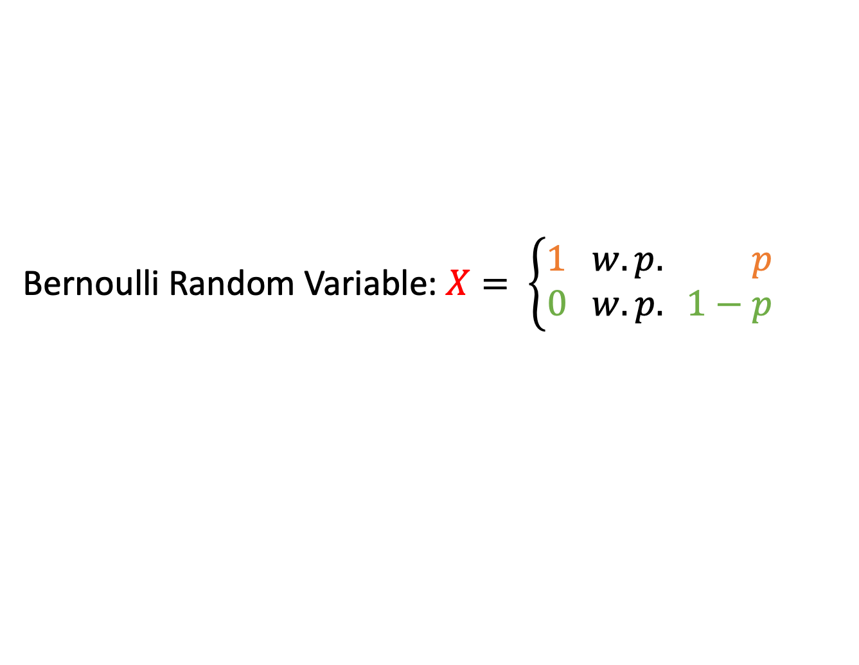
Probability Basics
Bernoulli Random Variable:$X= \left\{\begin{aligned}1 w.p. p \\ 0 w.p. 1−p\end{aligned}\right.$
If Independent:
Pr[X = x | Y = y] = Pr [X = x]
Pr[X = x and Y = y] = Pr[X = x]Pr[Y = y]
E[X] = Pr[X=1](1) + Pr[X=0](0) = (p)(1) + (1-p)(0) = p
  Markov Inequality:
  Pr[X >= a] <= E[X]/a

Slide 4
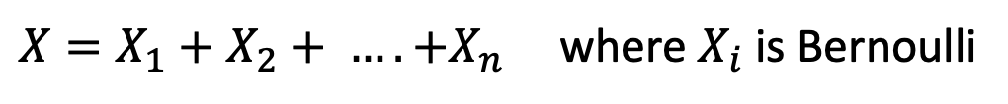
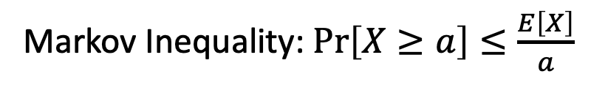
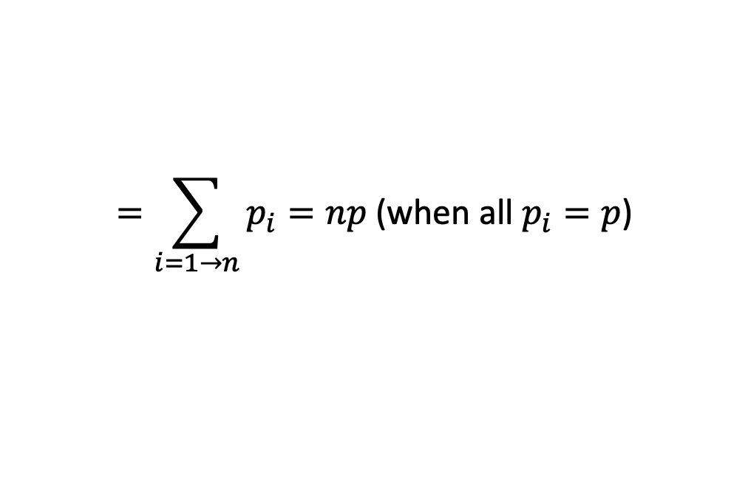
Our Old Friend Markov
$X=X_{1}+X_{2}+ …. +X_{n}$ where $X_{i}$ is Bernoulli
$$E[X]=E\left[X_{1}+X_{2}+ …X_{n}\right]=E\left[X_{1}\right]+E\left[X_{2}\right]+ …E\left[X_{n}\right]$$
$$=\sum_{i=1→n}{p_{i}}=np \text{(}\text{when} \text{all} p_{i}=p\text{)}$$
Markov Inequality: $\operatorname{Pr}\left[X≥a\right]≤\frac{E\left[X\right]}{a}$

Slide 5
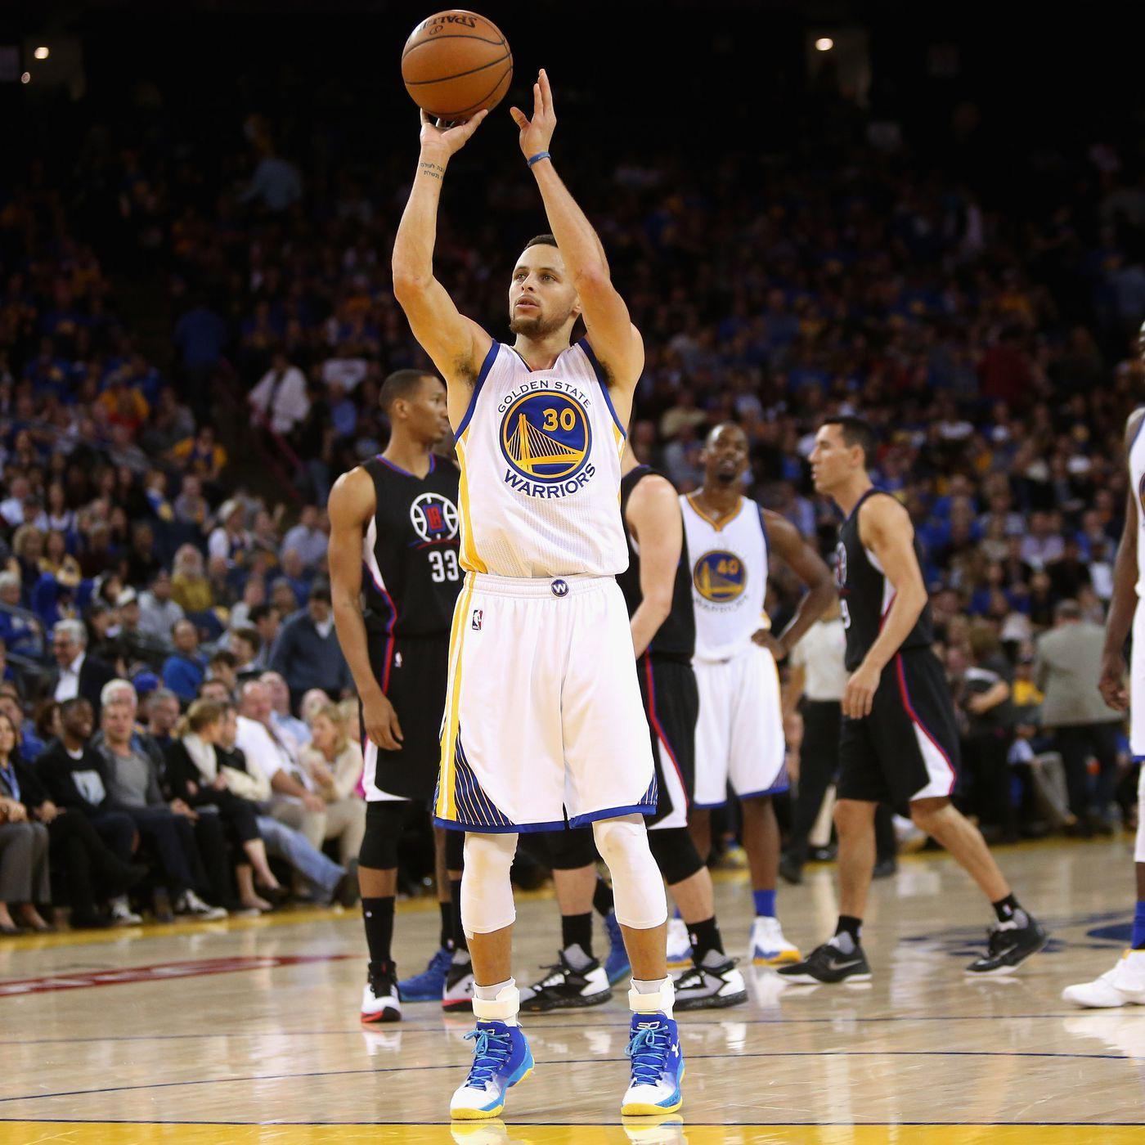
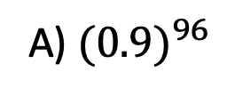
Analyzing the Hot Hand
Steph has made 95 consecutive free throws
Assuming every shot is independent, and curry shoots at 90%
What is the probability that curry makes 96th free throw ??
A) ${(0.9)}^{96}$
B) (0.9)
C) 1 [Curry is GOATED and cannot miss]

Slide 6
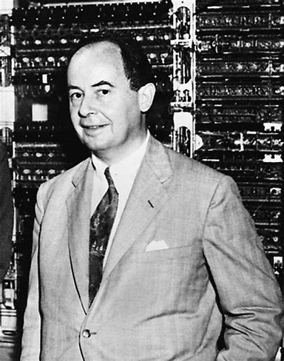
The von Nuemann Game
Input: Given a biased coin, heads with p, tails with (1-p)
Goal: Output a sequence of fair coin tosses

Slide 7
Bounding Bernoulli Tails

Slide 8
The Chernoff Bound
Should Georgetown Replace ChickFila with Panda Express?
Idea Polling:
Ask a bunch of people
  Get estimate of probability
  How far is estimate from True Probability??
  How many people should we go and ask

Slide 9

Secret Sharing
5 People find a doge coin out in the wild
They want to encrypt the doge coin using a special key, that they can only open only when all 5 people agree
What does the banker do?
Banker: Generate a key k, and 4 random strings
Person 1: k + r_1
Person 3: r_3 - r_2
Person 5: -r_4
Person 2: r_2 - r_1
Person 4: r_4 – r_3

Slide 10
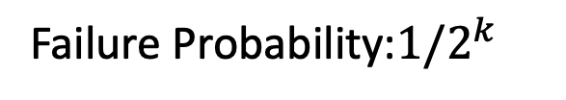

Find 1s
Open Research Question:
Is there a fast randomized alg,
that always outputs same answer?
Input: Given a string with 50% 1s, 50%0s
Output: Output an index with a 1 in it
What is the complexity of deterministic algorithm??
$$Ω(n)$$
What about a randomized algorithm??
Pick k random spots, inspect each spot
Failure Probability:$1/2^{k}$

Slide 11
Generate Prime between [N, 2N]
Open Research Question:
Always output the same prime
Imagine N to be a 200 digit prime
Naïve algorithm: Iterate from N -> 2N check if prime [Pseudo-polynomial]
Good news: Can check if a given number is prime in poly(#digits)
Prime Number Theorem: There are about N/log N primes from [1,….N]
Sample approximately 3 log N numbers between [n, 2n] w.h.p you can find a prime

Slide 12
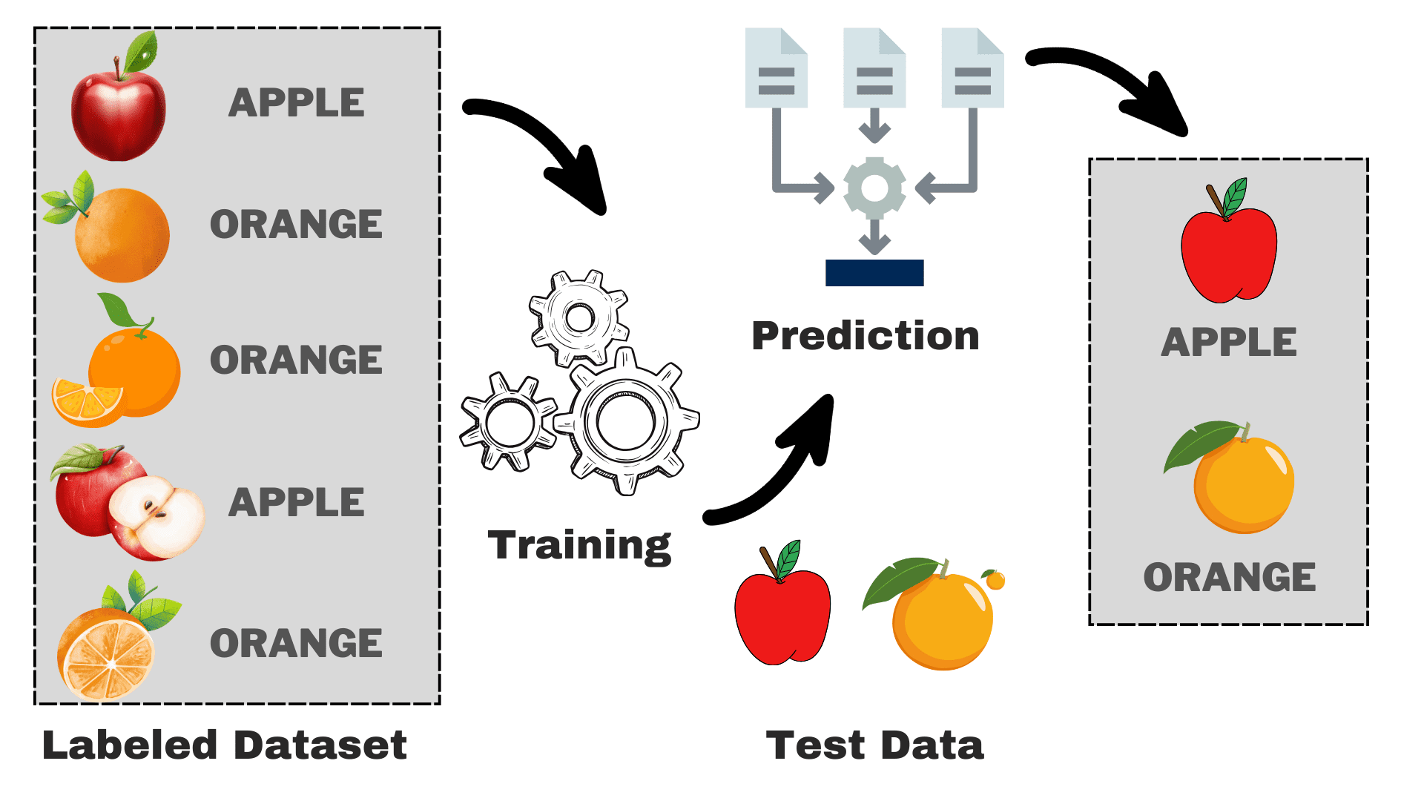
Machine Learning
Have a massive dataset
Sample small part of the world to train on
Algorithm makes predictions based on sample data

Slide 13
Many More Examples
Given 3 matrices A, B, and C: Verify AB = C
Exact Matching: Find a perfect matching with k-red edges and n-k blue edges
PIT: Given a polynomial, output 1 if it always evaluates to zero on all inputs
Byzantine Agreement
Interesting Questions in practice: How to coordinate randomness when dealing with parallel algorithms?

Slide 14
How do we formalize Randomness as a
P: Problems that can be solved in polynomial time
NP: Problems whose solution can be verified in polynomial time
BPP: Problems that can be solved using randomness in polynomial time
with probability > 2/3

Slide 15
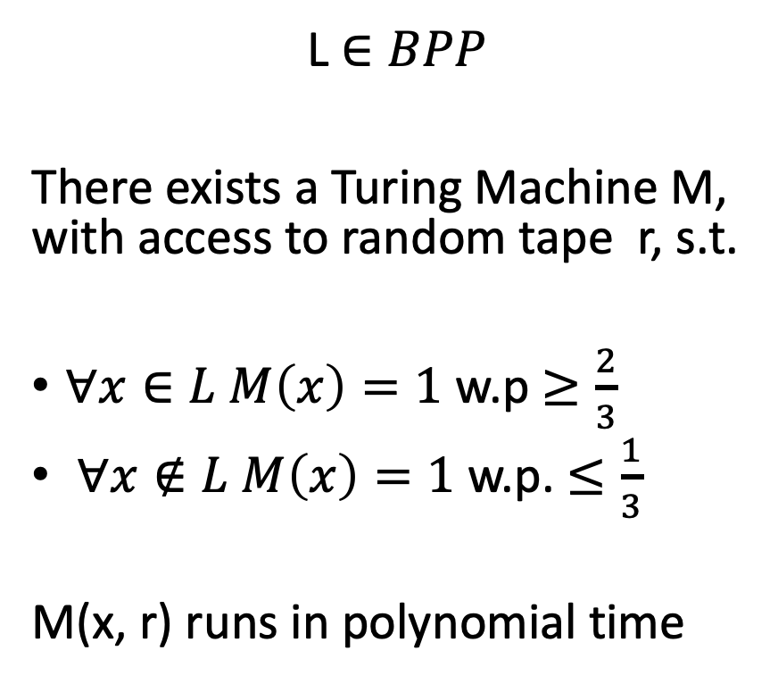
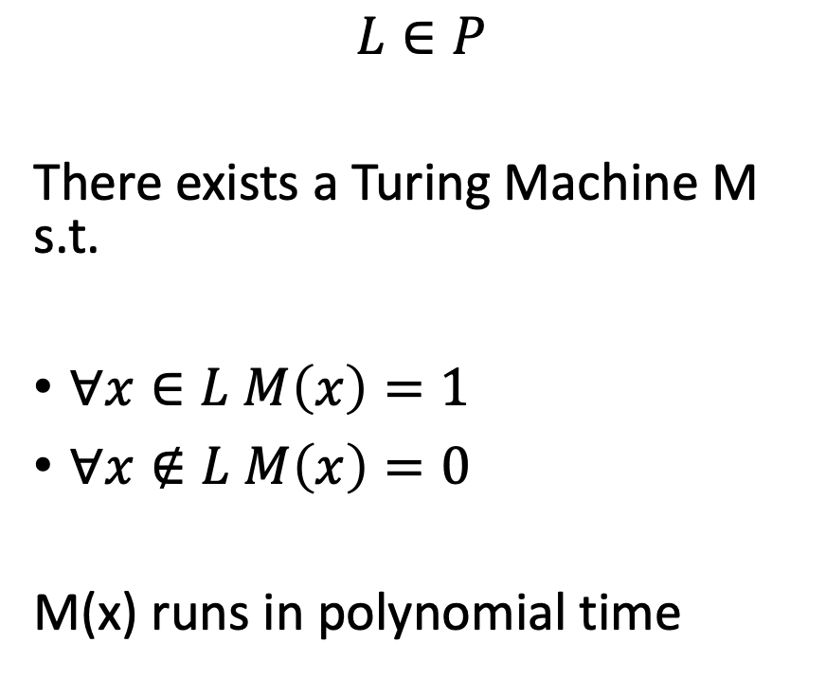
Formal Definitions
$$L∈P$$
There exists a Turing Machine M s.t.
$∀x∈L M\left(x\right)=1$
$∀x∉L M\left(x\right)=0$
M(x) runs in polynomial time
L $∈BPP$
There exists a Turing Machine M, with access to random tape r, s.t.
$∀x∈L M\left(x\right)=1$ w.p $≥\frac{2}{3}$
$∀x∉L M\left(x\right)=1$w.p. $≤\frac{1}{3}$
M(x, r) runs in polynomial time

Slide 16

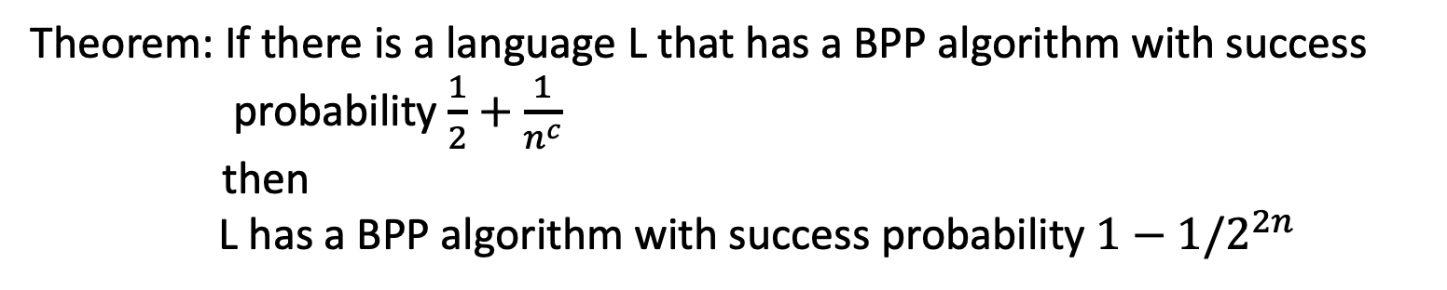
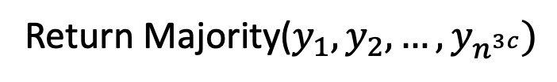
BPP error amplification
Theorem: If there is a language L that has a BPP algorithm with success probability $\frac{1}{2}+\frac{1}{n^{c}}$
then
L has a BPP algorithm with success probability $1−1/2^{2n}$
Run the algorithm $n^{3c}$ times
Return Majority($y_{1},y_{2},…, y_{n^{3c}})$

Slide 17
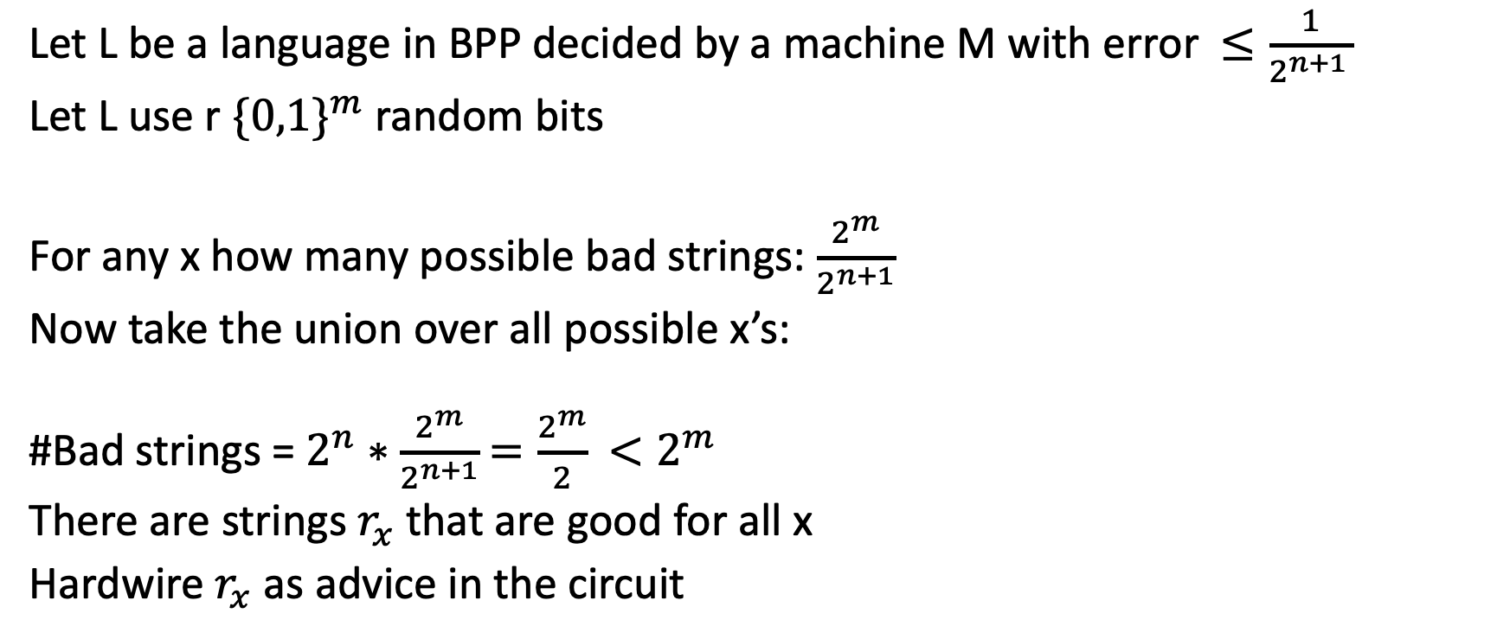
BPP in P/poly
Let L be a language in BPP decided by a machine M with error $≤\frac{1}{2^{n+1 }}$
Let L use r $\{0,1\}^{m}$ random bits
For any x how many possible bad strings: $\frac{2^{m}}{2^{n+1}}$
Now take the union over all possible x’s:
#Bad strings = $2^{n}∗$ $\frac{2^{m}}{2^{n+1}}$ $=\frac{2^{m}}{2}$ $<2^{m}$
There are strings $r_{x}$that are good for all x
Hardwire $r_{x}$ as advice in the circuit

Slide 18
BPP vs P
Do we really need randomness?

Slide 19
P = BPP
If you believe in hard functions, then you should believe that randomness is useless
If there is a function that is hard, then we can generate unpredictable bits (coin tosses from that)
Construction of PRG (Pseudorandom generator)
We are able to simulate randomness deterministically

Slide 20
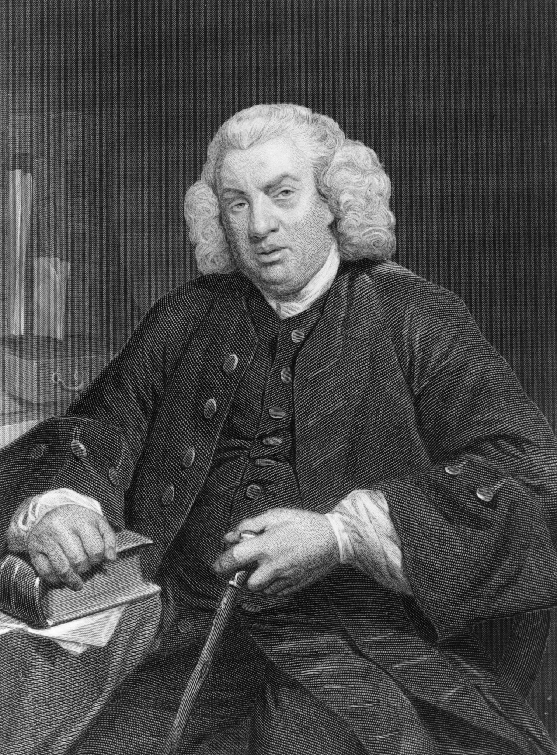
Giving Computers More Power
Samuel Johnson Quote
“All science is against the freedom of the will; all experience is for it.”

