Slide 1
Intro to Machine Learning Theory (PAC Learning)

Slide 2
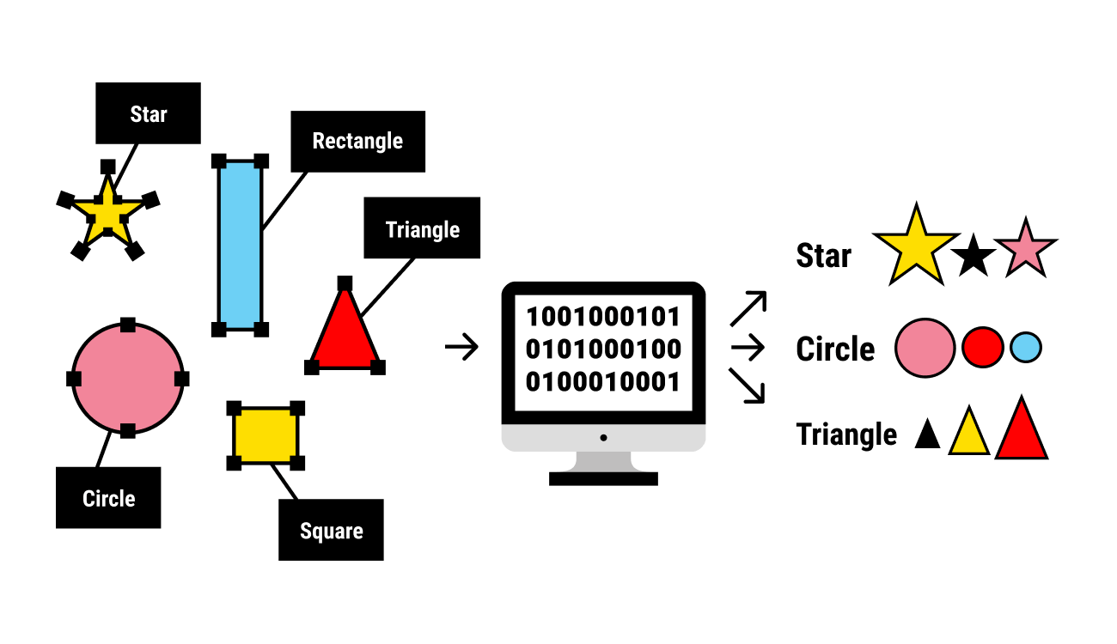
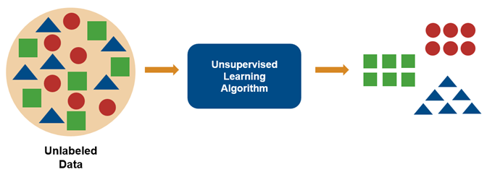
Lots of Learning Algorithms
Detecting Spam (Classification)
Selecting which web-page to display next (Ranking)
Stock Values (Regression)
Friends(Clustering)

Slide 3
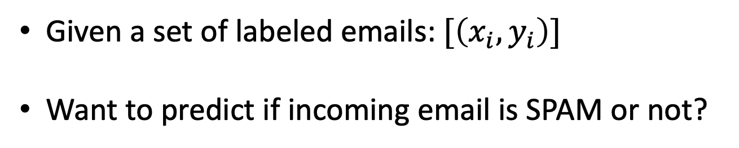
Example
Design a SPAM Filter for GMAIL
Example of Binary Classifier
Given a set of labeled emails: $[\left(x_{i}, y_{i}\right)]$
Want to predict if incoming email is SPAM or not?

Slide 4
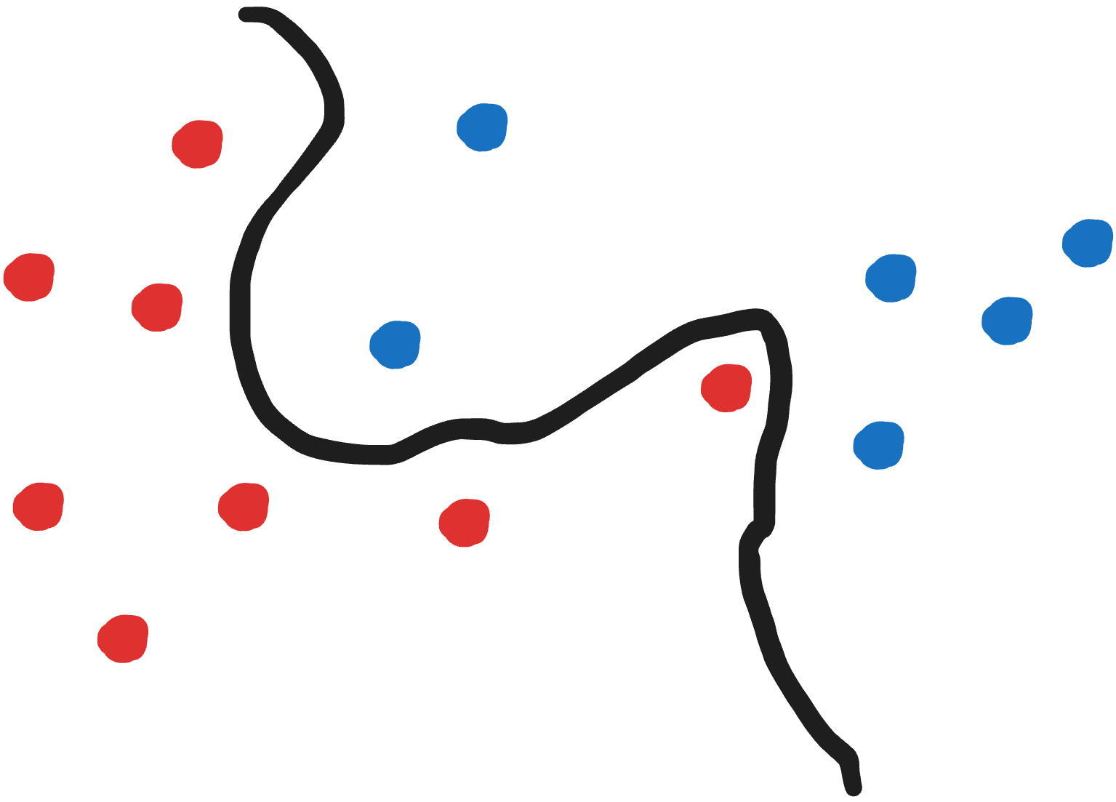
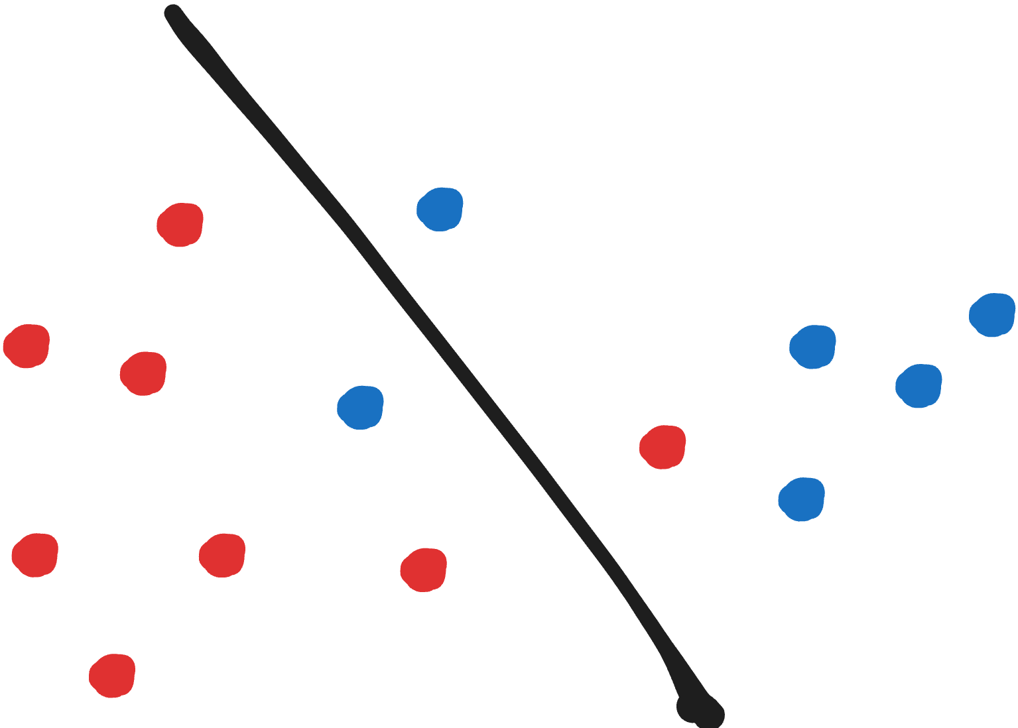
Learning Algorithm Setup
Partition Data into 3 Sets:
Training Data
Validation Data
Testing Data

Slide 5
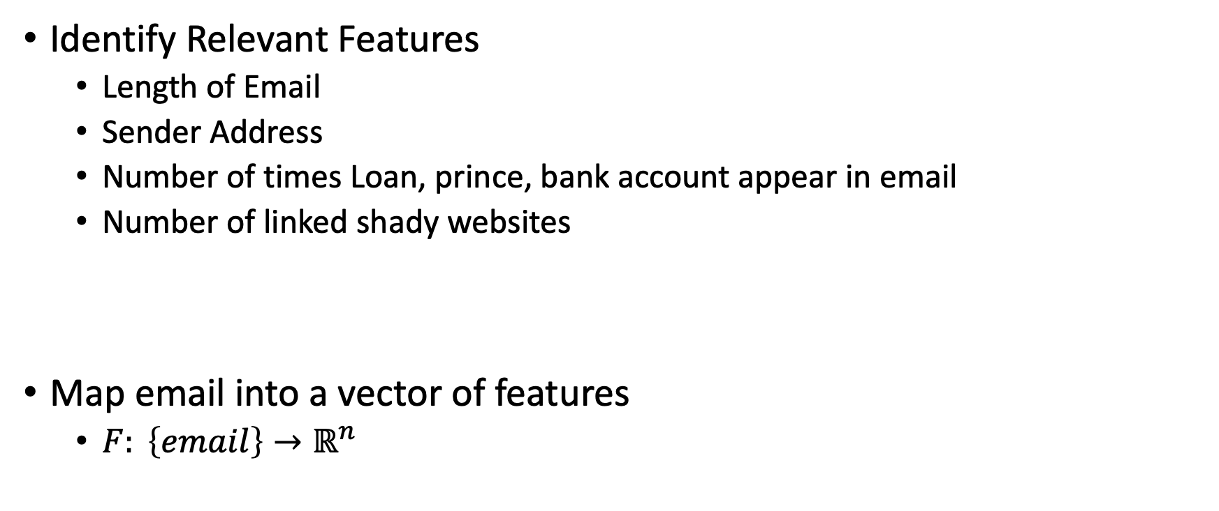
Learning Algorithm Setup
Identify Relevant Features
Length of Email
Sender Address
Number of times Loan, prince, bank account appear in email
Number of linked shady websites
Map email into a vector of features
$F: \left\{email\right\}→ℝ^{n}$

Slide 6
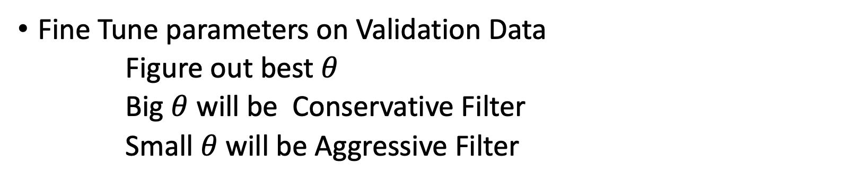
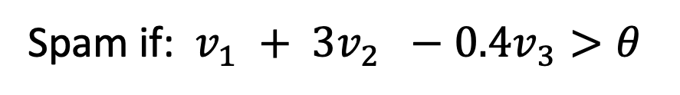
Learning Algorithm Setup
Build a model on Training Data
Spam if: $v_{1} + 3v_{2} −0.4v_{3}>θ$
Fine Tune parameters on Validation Data
Figure out best $θ$
Big $θ$ will be Conservative Filter
Small $θ$ will be Aggressive Filter
Evaluate model on Test Data for Accuracy

Slide 7
Machine Learning is very empirical field
Machine Learning is a very active field of research
Lot of research is experimental, trying new ideas
Can we use our toolkit of theoretical computer science to try and analyze learning algorithms?

Slide 8
Some concrete questions about learning:
What functions can be learnt
What functions can’t be learnt
How many samples do you need to learn?
Basis of PAC Learning [Valiant 84]

Slide 9
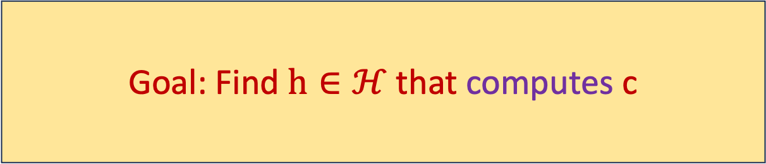
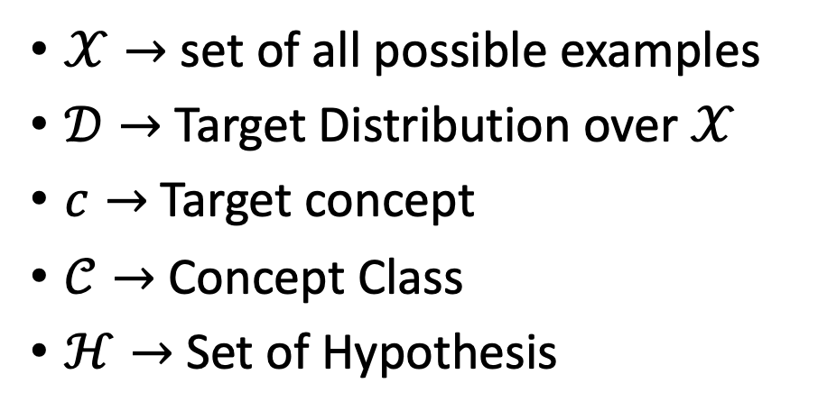
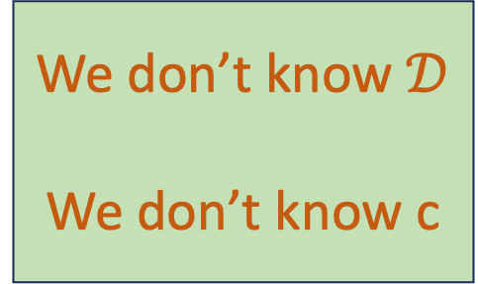
Let us try to formalize what Learning means
$𝒳→$ set of all possible examples
$𝒟→$Target Distribution over $𝒳$
$c→$Target concept
$𝒞→$ Concept Class
$ℋ→$ Set of Hypothesis
Goal: Find $h∈ℋ$ that computes c
We don’t know $𝒟$
We don’t know c

Slide 10
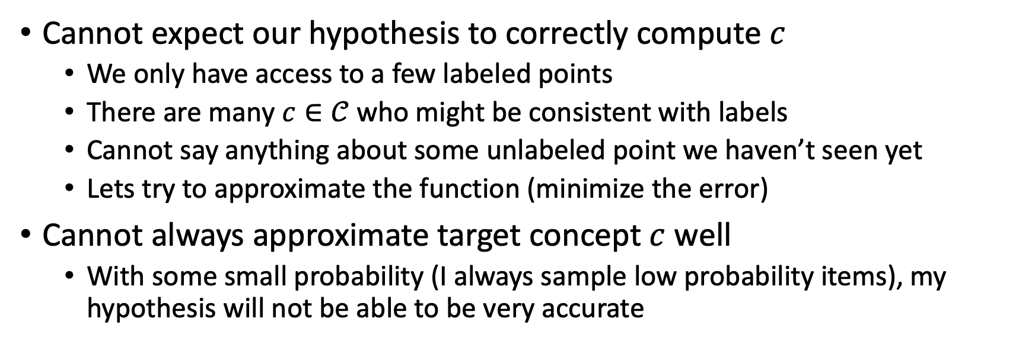
What does it mean for h to compute c
Cannot expect our hypothesis to correctly compute $c$
We only have access to a few labeled points
There are many $c∈𝒞$ who might be consistent with labels
Cannot say anything about some unlabeled point we haven’t seen yet
Lets try to approximate the function (minimize the error)
Cannot always approximate target concept $c$ well
With some small probability (I always sample low probability items), my hypothesis will not be able to be very accurate
Reasonable Goal: With high probability learner will find a close approximation of target concept

Slide 11
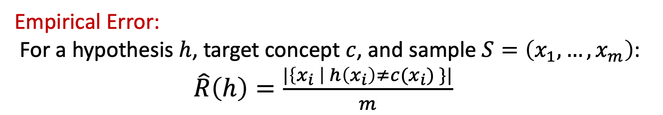
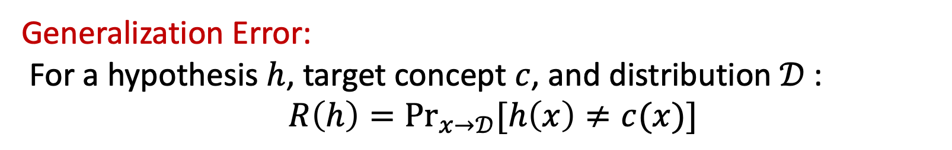
Making Errors
Generalization Error:
For a hypothesis $h$, target concept $c$, and distribution $𝒟$:
$R\left(h\right)=\underset{x→𝒟}{Pr}{[h\left(x\right)≠c(x)]}$
Empirical Error:
For a hypothesis $h$, target concept $c$, and sample $S=\left(x_{1},…, x_{m}\right)$:
$\hat{R}\left(h\right)=\frac{|\left\{x_{i} \right| h\left(x_{i}\right)≠c(x_{i}) \}|}{m}$

Slide 12
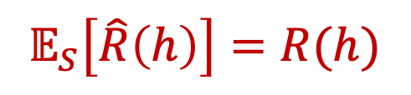
Connection Between Generalization Error and Empirical Error
$$𝔼_{S}\left[\hat{R}\left(h\right)\right]=R(h)$$

Slide 13

Define PAC Learning
Probably Approximately Correct (PAC) Learning:
A concept class is PAC learnable if there exists a learning algorithm such that:
For all $c, ε, δ, 𝒟:$
$$\underset{S \sim 𝒟}{Pr}\left[R\left(h_{s}\right)≤ε\right]≥1 −δ$$
For Random Samples of size:
$$m≤poly (\frac{1}{ε},\frac{1}{δ},n)$$

Slide 14


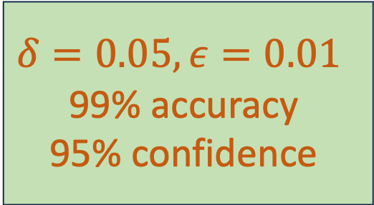
PAC Learning
Probably: Confidence $1 −δ$
$$δ=0.05, ε=0.01$$
99% accuracy
95% confidence
Approximately Correct: Accuracy 1- $ε$

Slide 15
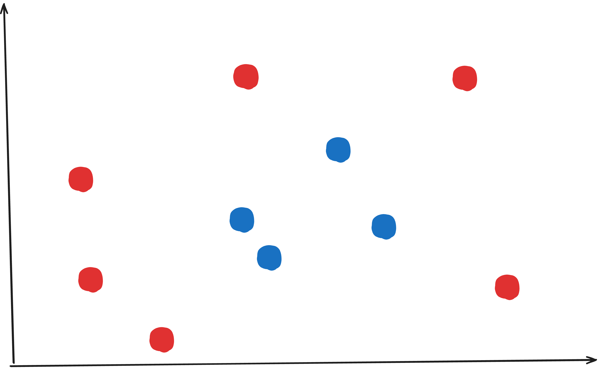
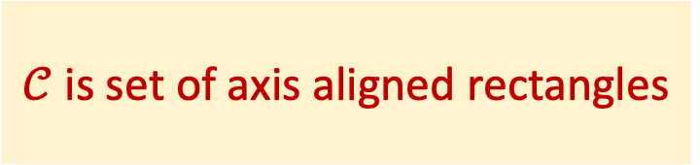
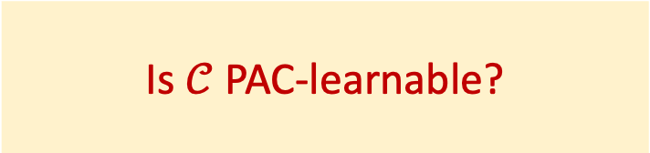
Example: Learning a Rectangle
$𝒞$ is set of axis aligned rectangles
Is $𝒞$ PAC-learnable?

Slide 16
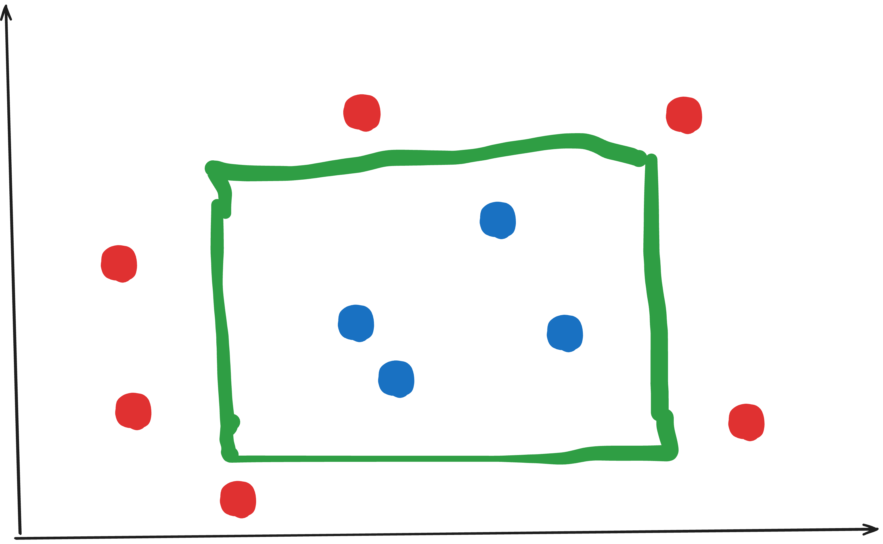
Example: Learning a Rectangle

Slide 17
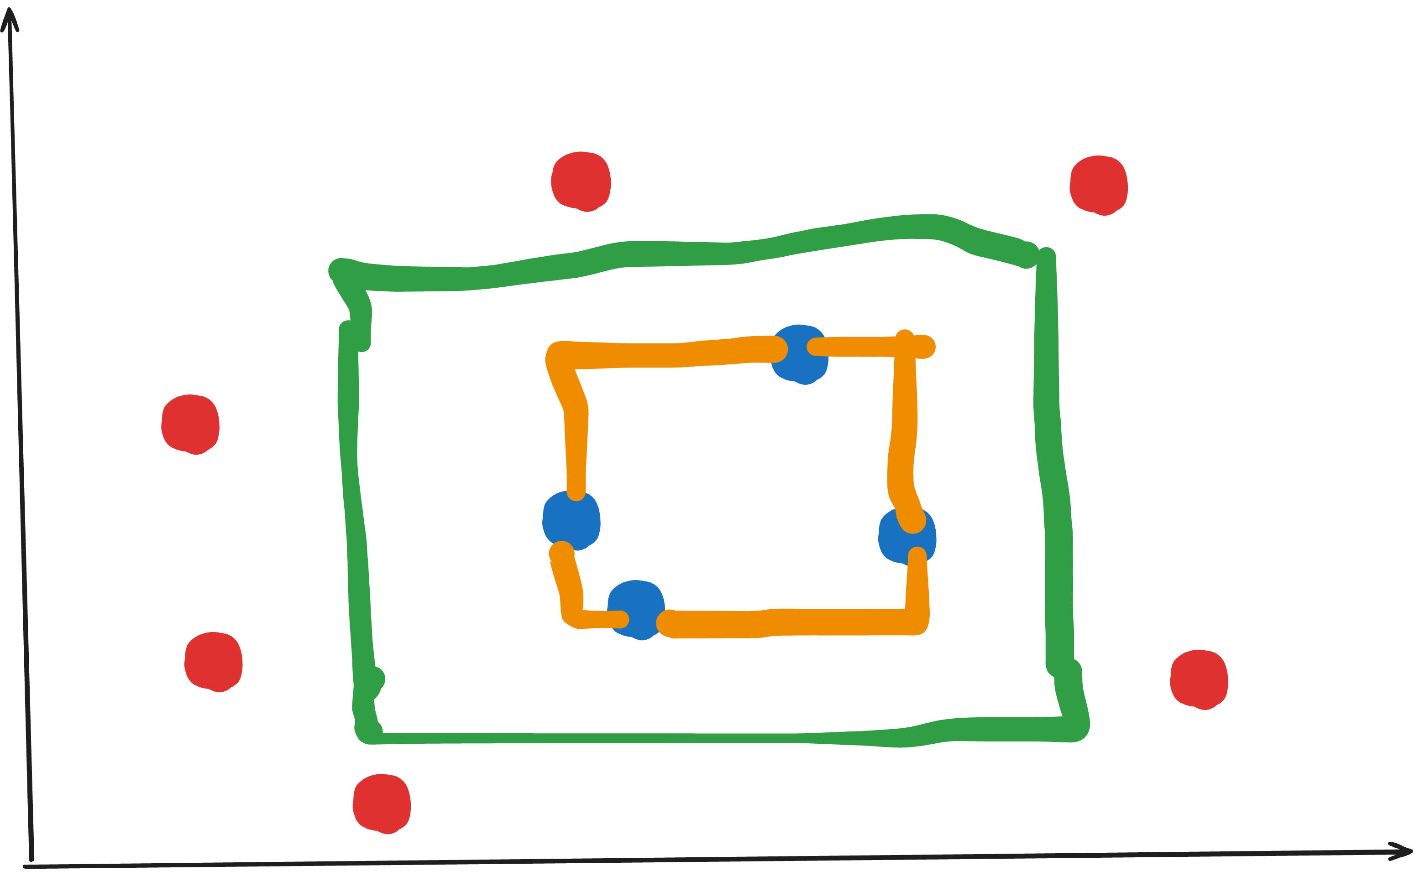
Example: Learning a Rectangle

Slide 18
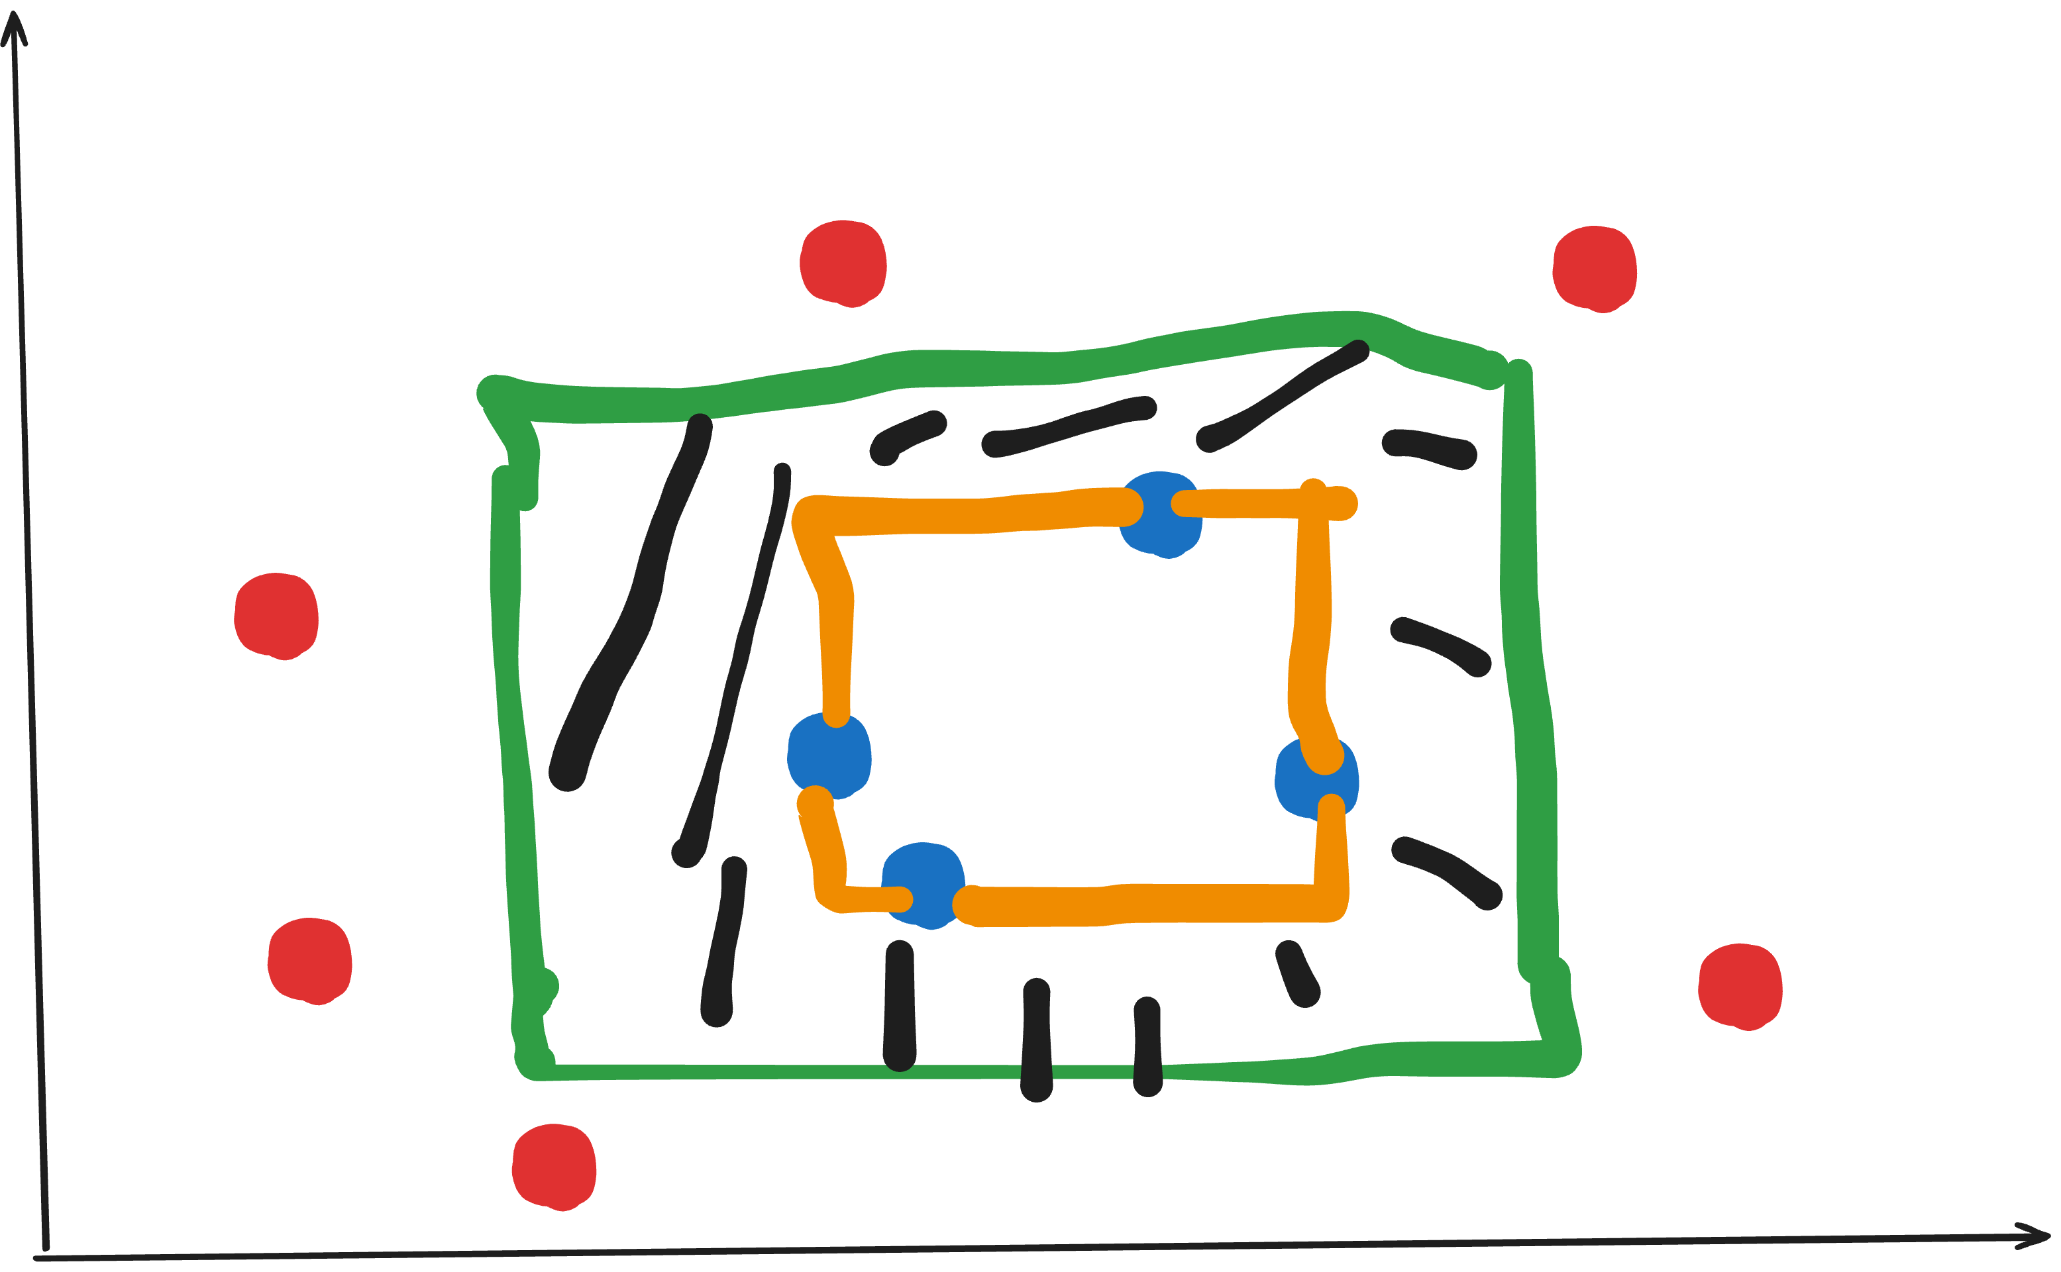
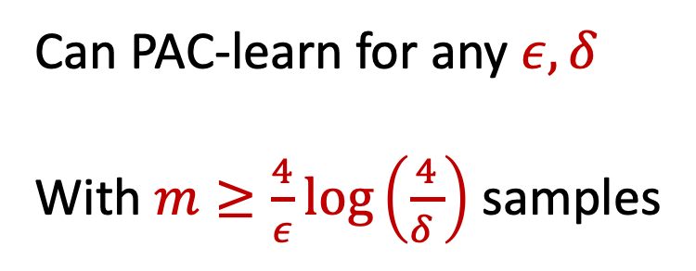
Example: Learning a Rectangle
Can PAC-learn for any $ε, δ$
With $m≥\frac{4}{ε}\log\left(\frac{4}{δ }\right)$ samples

Slide 19
So Far in Class we’ve learnt a lot of resources
Time: How much time Turing Machine to compute a function?
Space: How much memory does a program need to compute a function?
Randomness: Does randomness let you compute more functions?
Non-Determinism: Does non-determinism give you additional power?
Non-Uniformity: What is size of a Boolean Circuit computing function?
Communication Complexity: How many bits do two parties have to exchange to compute a function?
Today
Sample-Complexity: How many samples do we need to learn a function?

