Slide 1
Stable Matchings

Slide 2
How to win the Nobel Prize in Less than an Hour

Slide 3
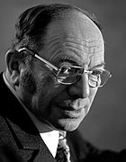
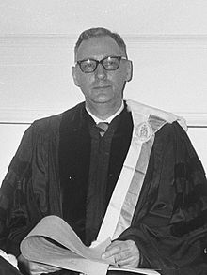

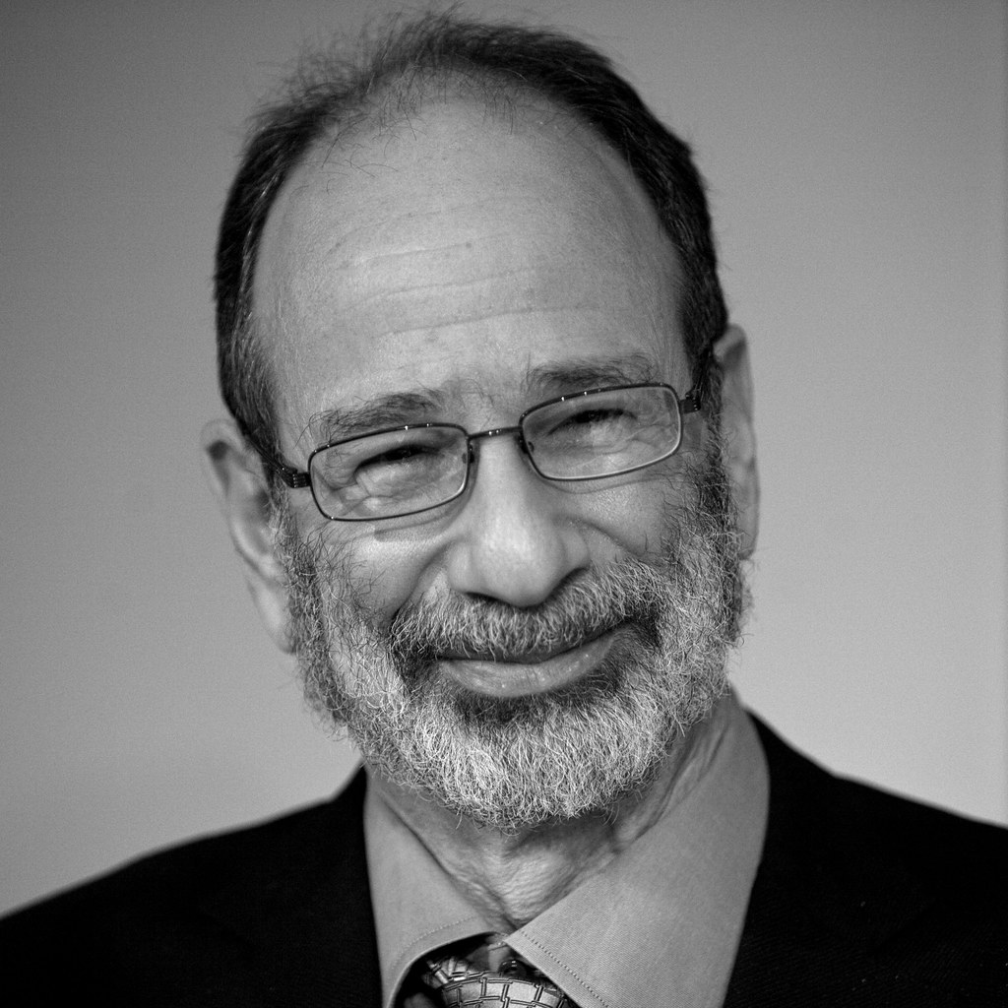
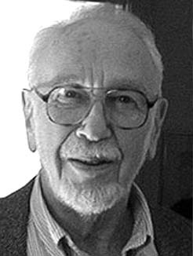
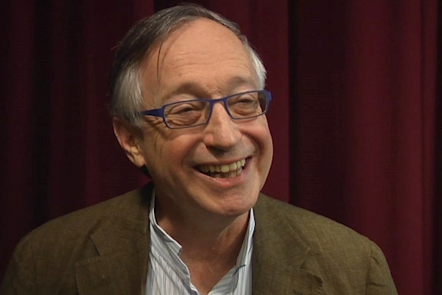
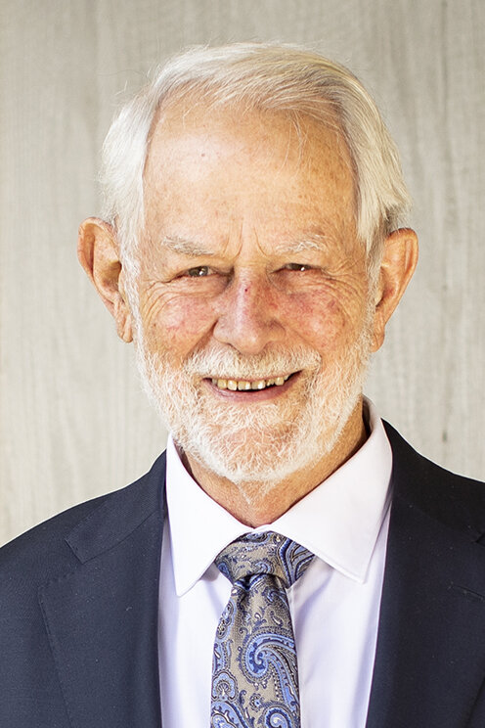
Connections between Algorithms and Nobel Prize in Economics
Linear Programming
(Kantorovich, Koopmans) 1974
Stable Matching
(Lloyd Shapley and Al Roth) 2012
Auction Theory
(Milgrom and Wilson) 2020

Slide 4
Connections between Theoretical Computer Science and Economics
Supply Chain Logistics and Operations Research
  [Linear Programming, Integer Programming, Convex Optimization]
Computing Market Equilibrium
  Hardness of finding Nash equilibrium
  Computing Equilibrium in Fisher Markets
Mechanism Design
  Designing polynomial time algorithms that are incentive compatible

Slide 5
Connections between Theoretical Computer Science and Economics
Combinatorial Auctions
Fair Allocation of Goods
Machine Learning and Regret Minimization
Many Connections between Game Theory and ML

Slide 6



One Sided Matching Markets
Preferences:
  Cardinal list
Run Auction on Houses
Hyland-Zeckhauser
John | 55 | 46 | 85
Jane | 66 | 73 | 0
Henry | 50 | 50 | 50

Slide 7
One Sided Matching Markets
Preferences:
  Ordinal list
Priority Rule
John | House 1 | House 2 | House 3
Jane | House 3 | House 1 | House 2
Henry | House 2 | House 1 | House 3
Random Priority
Top Trading Cycle

Slide 8
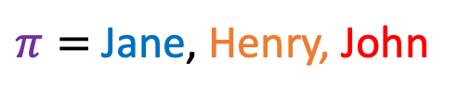
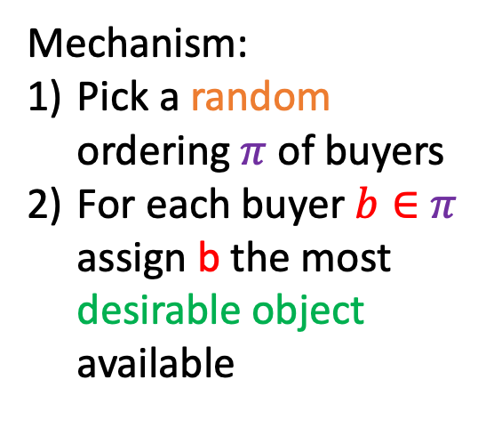
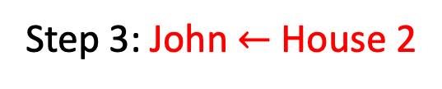
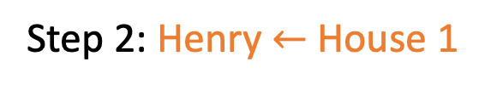
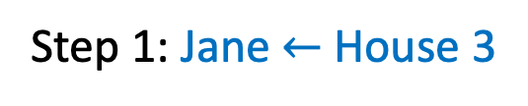
Priority Rule
Mechanism:
Pick a random ordering$π$ of buyers
For each buyer $b∈$ $π$ assign b the most desirable object available
$π=$Jane, Henry, John
Step 1: Jane $←$House 3
Pareto-Optimal
Step 2: Henry $←$ House 1
Incentive Compatible
Step 3: John $←$ House 2
Not Envy-Free
John | House 1 | House 3 | House 2
Jane | House 3 | House 1 | House 2
Henry | House 1 | House 2 | House 3

Slide 9
Two Sided Matching Markets
What happens when both sides have preferences ?
Examples:
Hospital And Residents (NRMP)
Students and Schools (Chicago, Boston, NYC)
Kidney Exchange
Speed Dating
Labor Markets
Both parties care about where they get matched

Slide 10
Shark Tank Game
N investors
N innovators
Match investors to innovators
Goal: Come up with an assignment of investors to innovators that is good???

Slide 11
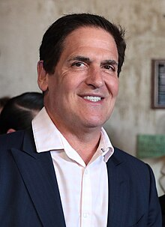
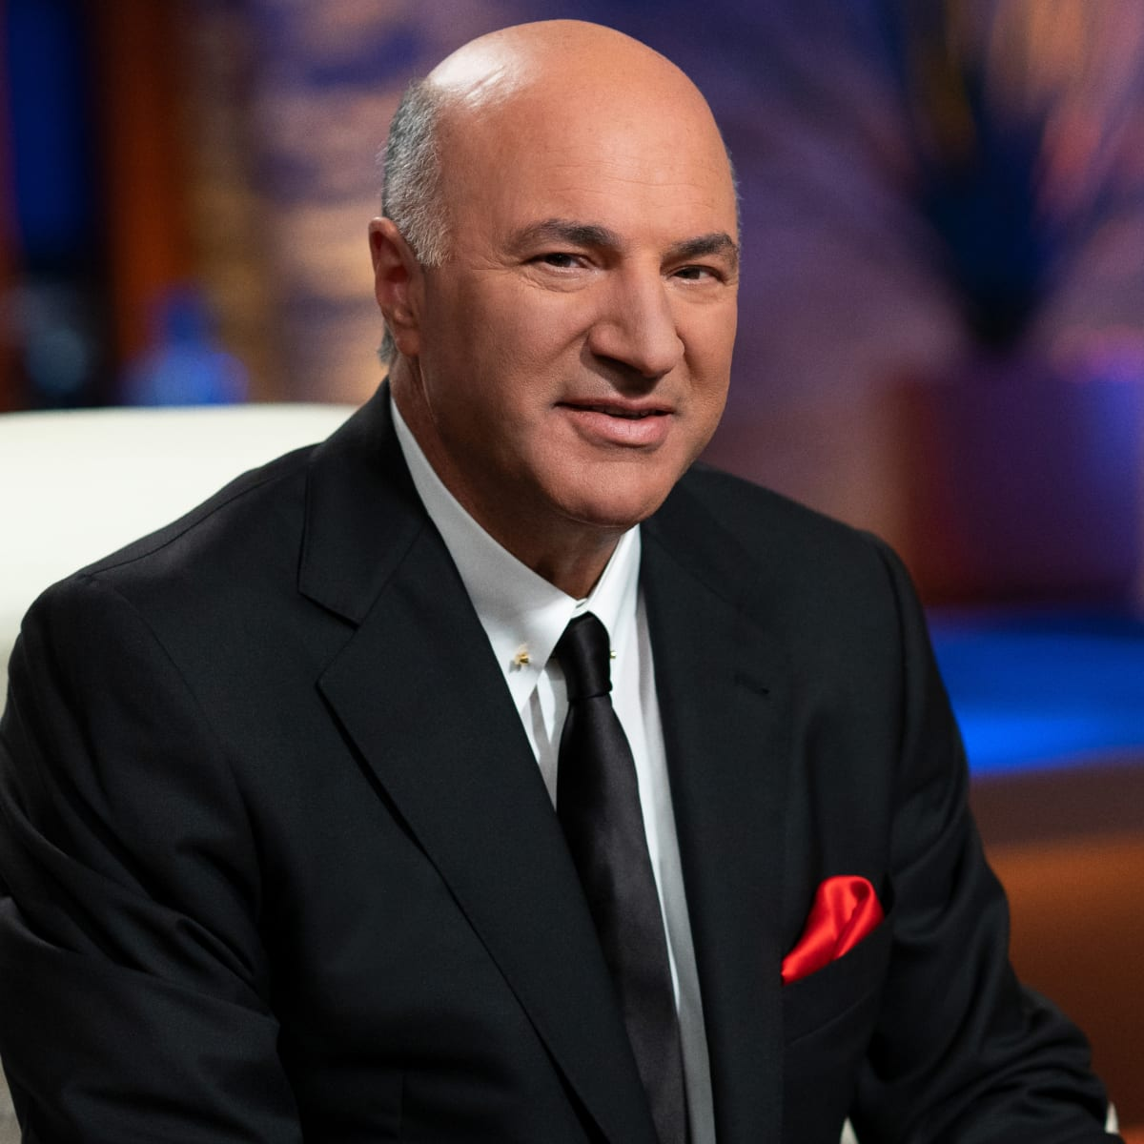
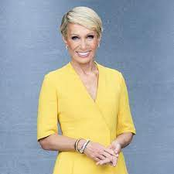
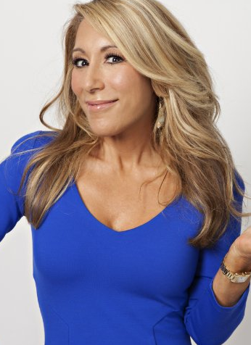

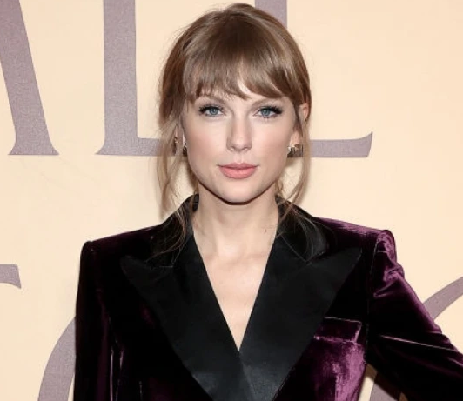
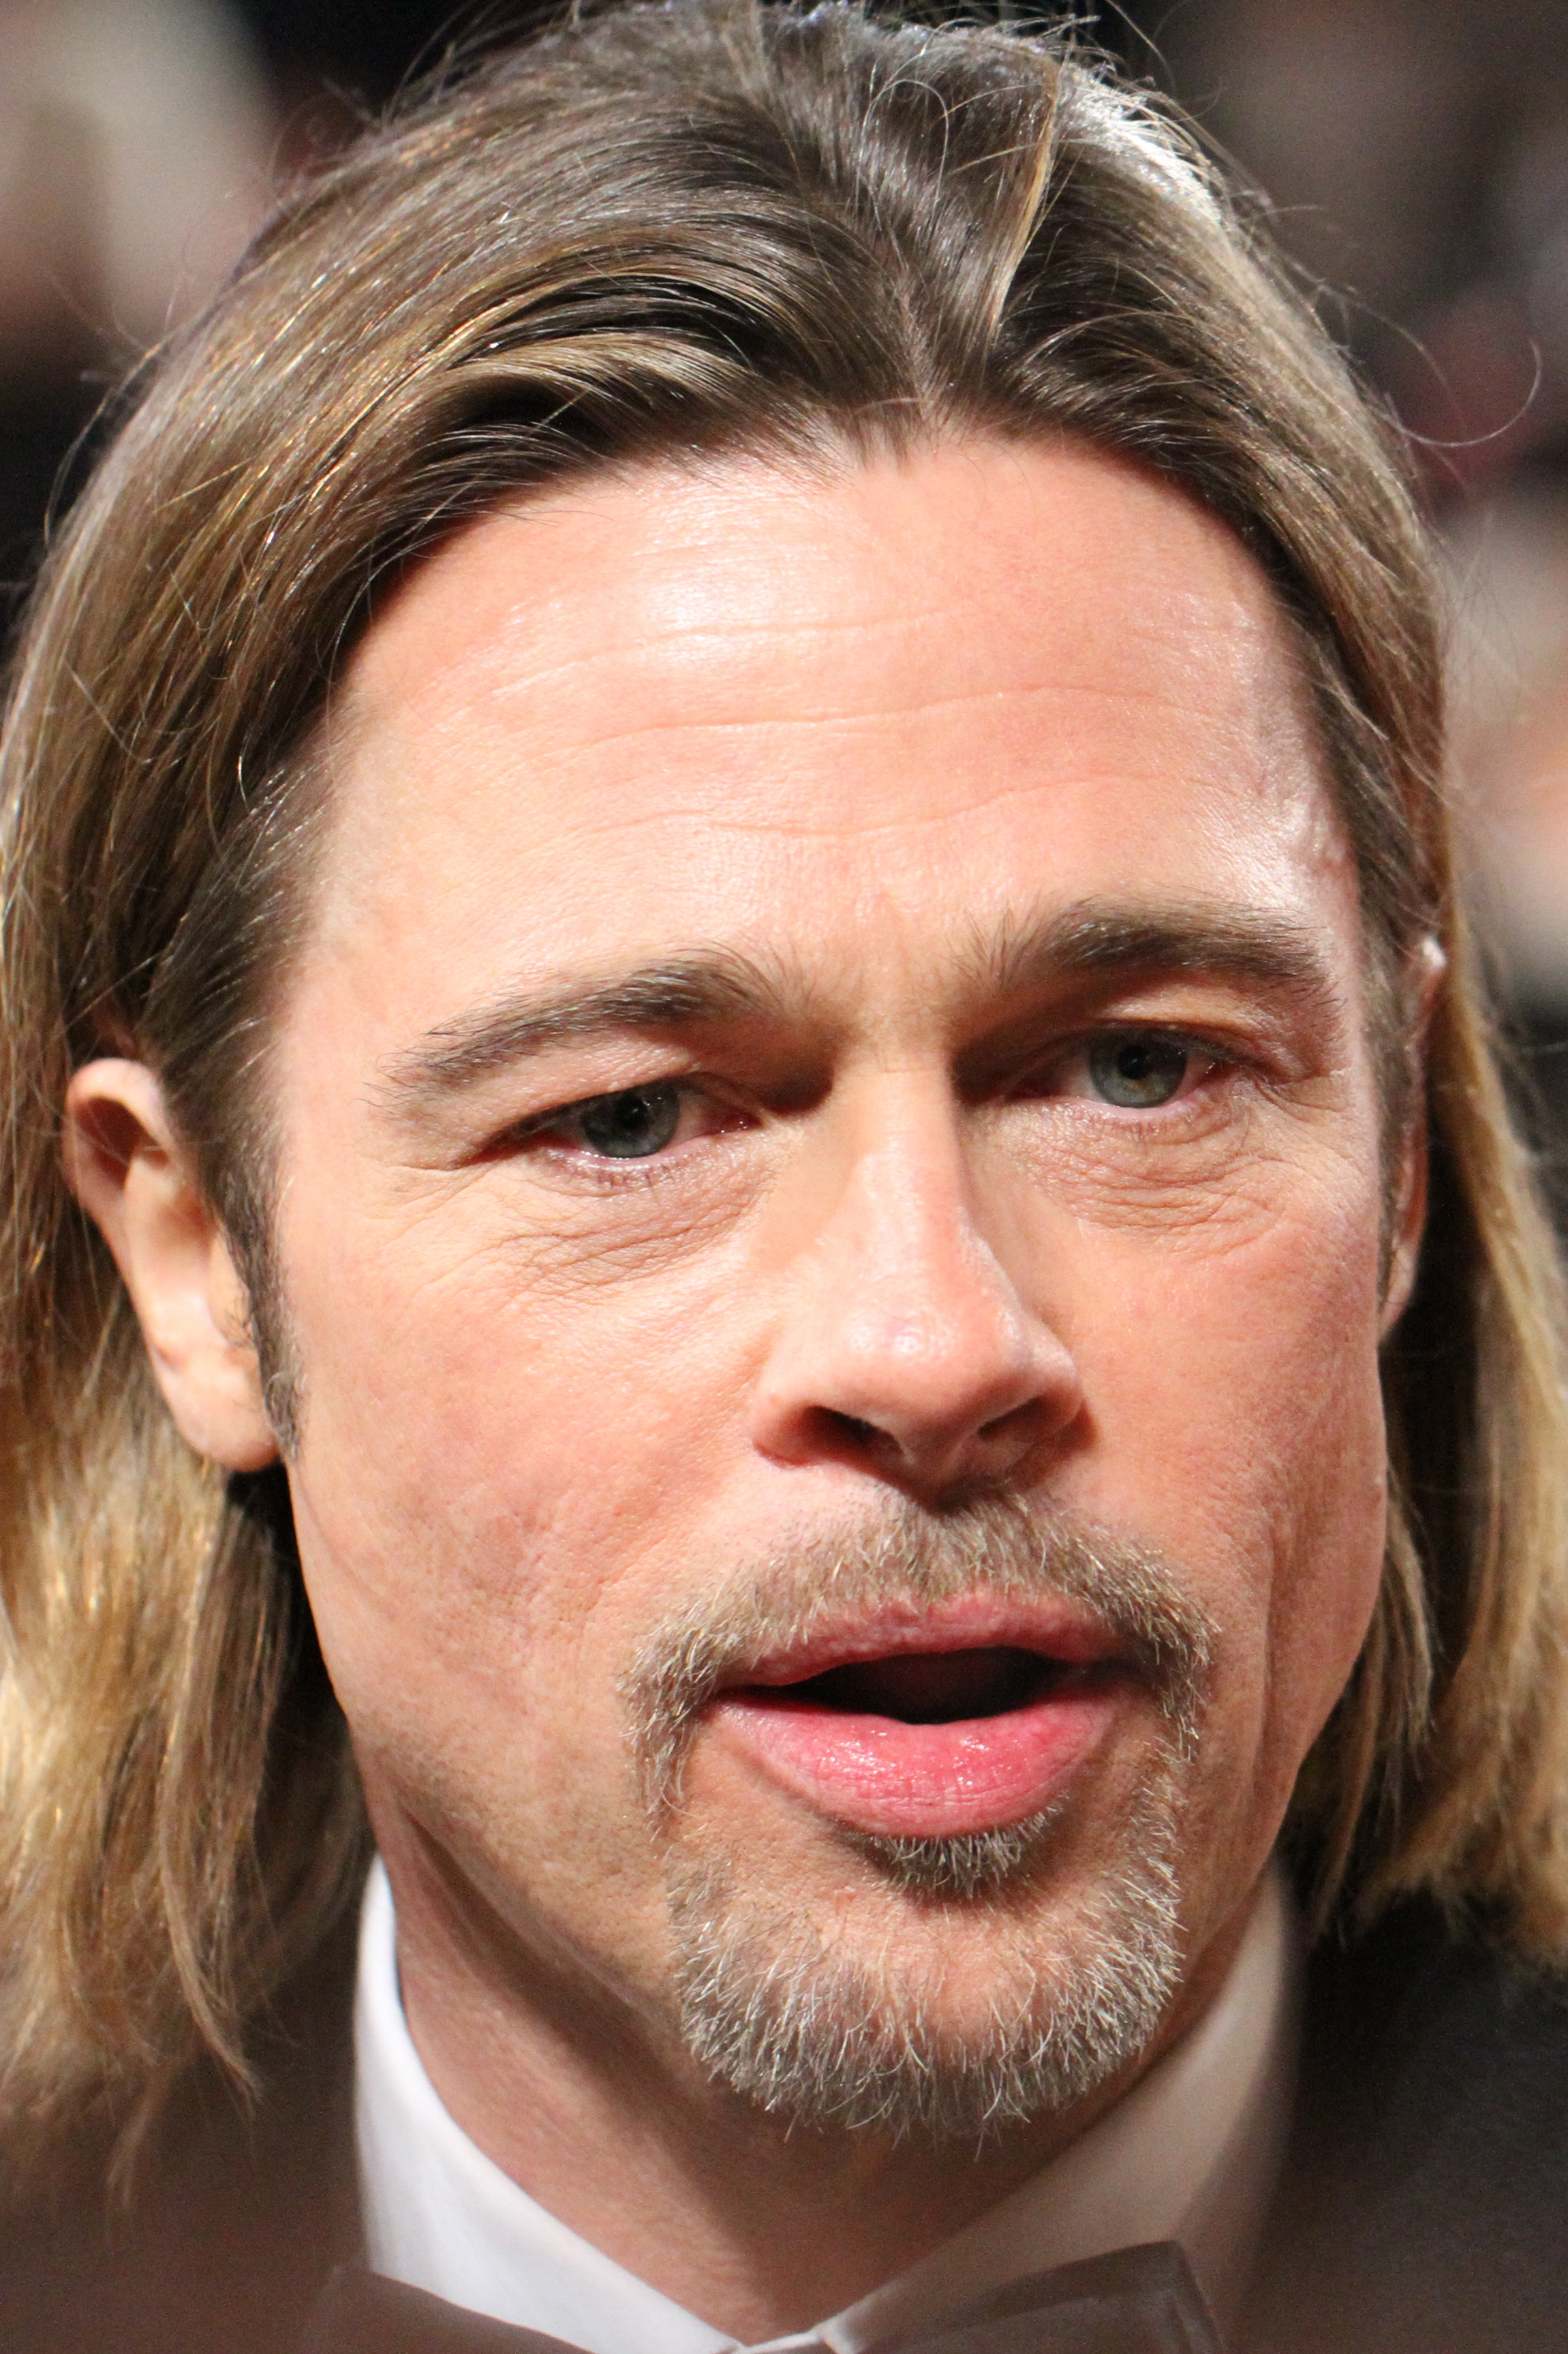
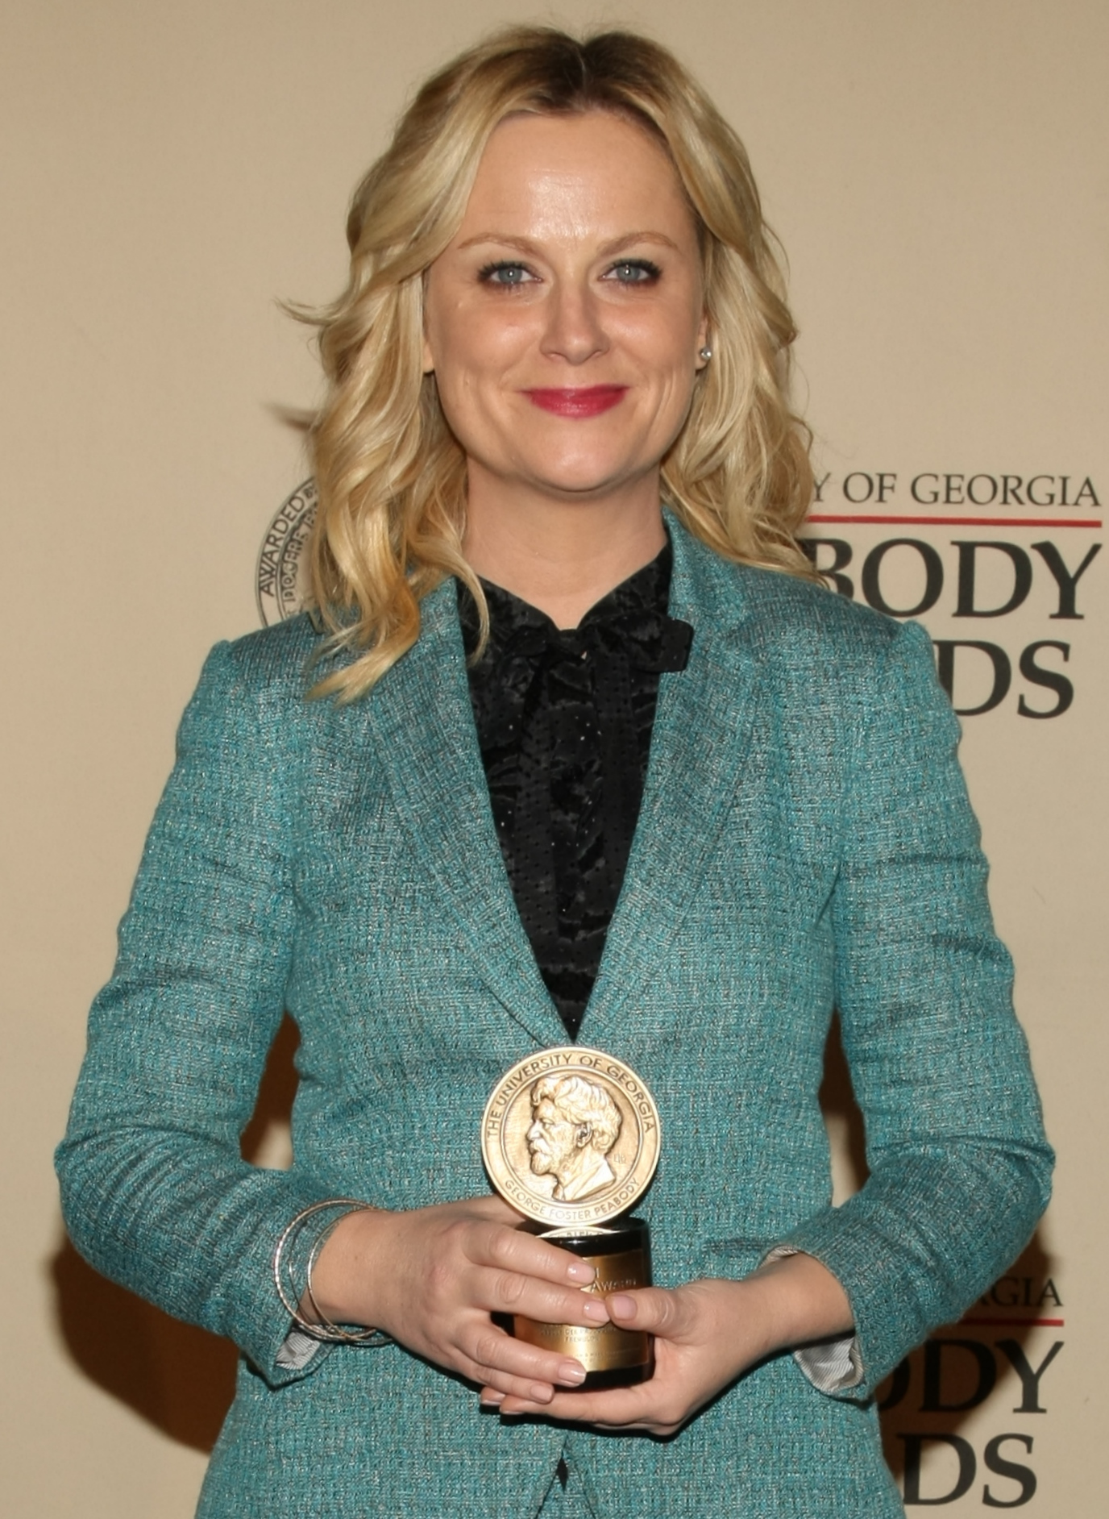
Investors
Mark
Kevin
Barbara
Lori
Innovators
LeBron
Taylor
Brad
Amy

Slide 12
Preference Lists
Investors
Mark | Lebron | Taylor | Amy | Brad
Kevin | Taylor | Brad | Amy | Lebron
Barbara | Brad | Lebron | Taylor | Amy
Lori | Amy | Taylor | Lebron | Brad
Innovators
Lebron | Mark | Barbara | Kevin | Lori
Taylor | Lori | Mark | Barbara | Kevin
Brad | Mark | Kevin | Lori | Barbara
Amy | Mark | Kevin | Lori | Barbara

Slide 13
Anything wrong with this assignment?
Mark | Lebron | Taylor | Amy | Brad
Kevin | Taylor | Brad | Amy | Lebron
Barbara | Brad | Lebron | Taylor | Amy
Lori | Amy | Taylor | Lebron | Brad
Lebron | Mark | Barbara | Kevin | Lori
Taylor | Lori | Mark | Barbara | Kevin
Brad | Mark | Kevin | Lori | Barbara
Amy | Mark | Kevin | Lori | Barbara
Lebron and Mark form a blocking pair

Slide 14
Stable Matching
Assignment with no blocking pair
Mark | Lebron | Taylor | Amy | Brad
Kevin | Taylor | Brad | Amy | Lebron
Barbara | Brad | Lebron | Taylor | Amy
Lori | Amy | Taylor | Lebron | Brad
Lebron | Mark | Barbara | Kevin | Lori
Taylor | Lori | Mark | Barbara | Kevin
Brad | Mark | Kevin | Lori | Barbara
Amy | Mark | Kevin | Lori | Barbara

Slide 15
One More example
Mark | Lebron | Taylor | Amy | Brad
Kevin | Taylor | Brad | Amy | Lebron
Barbara | Brad | Lebron | Taylor | Amy
Lori | Amy | Taylor | Lebron | Brad
Lebron | Mark | Barbara | Kevin | Lori
Taylor | Lori | Mark | Barbara | Kevin
Brad | Mark | Kevin | Lori | Barbara
Amy | Mark | Kevin | Lori | Barbara

Slide 16
Stable Matching
Stable Matching: Find an assignment with no blocking pair (GOOD!!!)
Formalize in TCS terms:
  Given a complete bipartite graph, and preference list
  Return a perfect matching with no blocking pairs

Slide 17
Natural Questions
Does there always exist a stable matching?
If it does exist, is there an efficient way to find it?
Are there more than one solution, is there a way of measuring quality of the solution?

Slide 18
Gale-Shapley (Differed Accept Algorithm) [DA]
Initially we start with an empty matching
While (there exists an unmatched innovator)
  Unmatched innovator (Alice) proposes to highest ranked investor on list (Bob) who hasn’t rejected them
    Case 1: Bob is currently unmatched and now tentatively accepts Alice
    Case 2: Bob is currently matched to Carol, but prefers Alice to Carol (Alice is now matched to Bob, and Carol is unmatched)
    Case 3: Bob is currently matched to Carol, but prefers Carol to Alice (Alice remains unmatched)

Slide 19
Visual Example of DA
Mark | Lebron | Taylor | Amy | Brad
Kevin | Taylor | Brad | Amy | Lebron
Barbara | Brad | Lebron | Taylor | Amy
Lori | Amy | Taylor | Lebron | Brad
Lebron | Mark | Barbara | Kevin | Lori
Taylor | Lori | Mark | Barbara | Kevin
Brad | Mark | Kevin | Lori | Barbara
Amy | Mark | Kevin | Lori | Barbara

Slide 20
Visual Example of DA
Mark | Lebron | Taylor | Amy | Brad
Kevin | Taylor | Brad | Amy | Lebron
Barbara | Brad | Lebron | Taylor | Amy
Lori | Amy | Taylor | Lebron | Brad
Lebron | Mark | Barbara | Kevin | Lori
Taylor | Lori | Mark | Barbara | Kevin
Brad | Mark | Kevin | Lori | Barbara
Amy | Mark | Kevin | Lori | Barbara

Slide 21
Visual Example of DA
Mark | Lebron | Taylor | Amy | Brad
Kevin | Taylor | Brad | Amy | Lebron
Barbara | Brad | Lebron | Taylor | Amy
Lori | Amy | Taylor | Lebron | Brad
Lebron | Mark | Barbara | Kevin | Lori
Taylor | Lori | Mark | Barbara | Kevin
Brad | Mark | Kevin | Lori | Barbara
Amy | Mark | Kevin | Lori | Barbara

Slide 22
Visual Example of DA
Mark | Lebron | Taylor | Amy | Brad
Kevin | Taylor | Brad | Amy | Lebron
Barbara | Brad | Lebron | Taylor | Amy
Lori | Amy | Taylor | Lebron | Brad
Lebron | Mark | Barbara | Kevin | Lori
Taylor | Lori | Mark | Barbara | Kevin
Brad | Mark | Kevin | Lori | Barbara
Amy | Mark | Kevin | Lori | Barbara

Slide 23
Visual Example of DA
Mark | Lebron | Taylor | Amy | Brad
Kevin | Taylor | Brad | Amy | Lebron
Barbara | Brad | Lebron | Taylor | Amy
Lori | Amy | Taylor | Lebron | Brad
Lebron | Mark | Barbara | Kevin | Lori
Taylor | Lori | Mark | Barbara | Kevin
Brad | Mark | Kevin | Lori | Barbara
Amy | Mark | Kevin | Lori | Barbara

Slide 24
Visual Example of DA
Mark | Lebron | Taylor | Amy | Brad
Kevin | Taylor | Brad | Amy | Lebron
Barbara | Brad | Lebron | Taylor | Amy
Lori | Amy | Taylor | Lebron | Brad
Lebron | Mark | Barbara | Kevin | Lori
Taylor | Lori | Mark | Barbara | Kevin
Brad | Mark | Kevin | Lori | Barbara
Amy | Mark | Kevin | Lori | Barbara

Slide 25
Visual Example of DA
Mark | Lebron | Taylor | Amy | Brad
Kevin | Taylor | Brad | Amy | Lebron
Barbara | Brad | Lebron | Taylor | Amy
Lori | Amy | Taylor | Lebron | Brad
Lebron | Mark | Barbara | Kevin | Lori
Taylor | Lori | Mark | Barbara | Kevin
Brad | Mark | Kevin | Lori | Barbara
Amy | Mark | Kevin | Lori | Barbara

Slide 26
Visual Example of DA
Mark | Lebron | Taylor | Amy | Brad
Kevin | Taylor | Brad | Amy | Lebron
Barbara | Brad | Lebron | Taylor | Amy
Lori | Amy | Taylor | Lebron | Brad
Lebron | Mark | Barbara | Kevin | Lori
Taylor | Lori | Mark | Barbara | Kevin
Brad | Mark | Kevin | Lori | Barbara
Amy | Mark | Kevin | Lori | Barbara

Slide 27
Visual Example of DA
Mark | Lebron | Taylor | Amy | Brad
Kevin | Taylor | Brad | Amy | Lebron
Barbara | Brad | Lebron | Taylor | Amy
Lori | Amy | Taylor | Lebron | Brad
Lebron | Mark | Barbara | Kevin | Lori
Taylor | Lori | Mark | Barbara | Kevin
Brad | Mark | Kevin | Lori | Barbara
Amy | Mark | Kevin | Lori | Barbara

Slide 28
Visual Example of DA
Mark | Lebron | Taylor | Amy | Brad
Kevin | Taylor | Brad | Amy | Lebron
Barbara | Brad | Lebron | Taylor | Amy
Lori | Amy | Taylor | Lebron | Brad
Lebron | Mark | Barbara | Kevin | Lori
Taylor | Lori | Mark | Barbara | Kevin
Brad | Mark | Kevin | Lori | Barbara
Amy | Mark | Kevin | Lori | Barbara

Slide 29
Why does this work???
Check 3 things
1) Runs in polynomial time
2) Everybody is assigned a partner
3) Assignment is stable

Slide 30
DA runs in polynomial time
At every step one proposal is made
Only n^2 proposals
So at most n^2 steps

Slide 31
DA returns a perfect matching
(All innovators are assigned an investor)
Proof by contradiction
Let there be an innovator (Alice) who has not been matched
This means that there is also an investor (Bob) who is currently unmatched
But DA ensures that Alice proposes to all investors including Bob during its iteration
Hence Bob must have been matched to someone better than Alice when she proposed
But in DA once an investor is assigned a partner, they are never unmatched (they can only get better)
Contradiction !!!!

Slide 32
DA returns a stable matching
Again we prove by contradiction:
Assume (Alice, Bob) form a blocking pair, and M is the assignment outputted by DA
Then in M, Alice and Bob must have partners ( Carol and David) s.t. (Alice, Carol) and (David, Bob) are in M
And since (Alice, Bob) form a blocking pair Alice prefers Bob to Carol and Bob prefers Alice to David
But in DA Alice must have proposed to Bob and got rejected
But if Bob rejected Alice then that means that he must have been matched to someone better (since Bob can only improve quality of their match)
Bob must prefer David to Alice, hence (Alice,Bob) is not a blocking pair
Contradiction !!!!

Slide 33
How Happy are Innovators ??
Mark | Lebron | Taylor | Amy | Brad
Kevin | Taylor | Brad | Amy | Lebron
Barbara | Brad | Lebron | Taylor | Amy
Lori | Amy | Taylor | Lebron | Brad
Lebron | Mark | Barbara | Kevin | Lori
Taylor | Lori | Mark | Barbara | Kevin
Brad | Mark | Kevin | Lori | Barbara
Amy | Mark | Kevin | Lori | Barbara
Very Happy

Slide 34
How Happy are Investors ??
Mark | Lebron | Taylor | Amy | Brad
Kevin | Taylor | Brad | Amy | Lebron
Barbara | Brad | Lebron | Taylor | Amy
Lori | Amy | Taylor | Lebron | Brad
Lebron | Mark | Barbara | Kevin | Lori
Taylor | Lori | Mark | Barbara | Kevin
Brad | Mark | Kevin | Lori | Barbara
Amy | Mark | Kevin | Lori | Barbara
Very Unhappy

Slide 35
Properties of DA
DA returns an innovator-optimal stable matching
  Every innovator is matched to the best possible partner they can get in a stable matching
DA returns an investor-pessimal stable matching
  Every investor is matched to the worst possible partner they can get in a stable matching
DA is Dominant Strategy Incentive Compatible
  Lying about your preferences will not improve which partner you are assigned, it will only hurt you

Slide 36
DA finds an innovator-optimal matching
Valid Partner (Alice): Bob is a valid partner of Alice, if there exists a stable matching where Alice is matched to Bob.
Let us prove by contradiction:
Assume that DA is not innovator-optimal, and M is the matching returned by DA
This means that there is an innovator who was rejected by a valid partner during DA
Let Alice be the first innovator who gets rejected by a valid partner (Bob), and let Bob be matched to Carol in M

Slide 37
DA finds an innovator optimal matching
Since Bob is a valid partner of Alice, consider the stable matching M’ where (Alice, Bob) are matched
Bob must prefer Carol to Alice, since he rejected her during DA
Since we picked the first person to get rejected by a valid partner, Carol was never rejected by a valid partner and hence must prefer Bob to whomever she’s matched to in M’
(Carol, Bob) form a blocking pair in M’
Contradiction !!!

Slide 38
DA finds an investor-pessimal matching
Again let us use our friend contradiction
Assume that the matching M found by DA is not investor-pessimal, that is there is a Bob for which Alice is not the worst valid partner
Then there exists a stable matching M’ where Bob is matched to Carol (his least favorite valid partner)
Then in M’ Alice is matched to someone worse than Bob (since Bob is Alice’s top valid partner (previous slide)
(Alice, Bob) form a blocking pair in M’
Contradiction !!!!

Slide 39
What if we wanted to make investors happy instead?
Run DA where the investors propose

Slide 40
More generalized version
Set of Schools
Each school has a fixed capacity of students
Schools have preference lists over students
Students have preference lists over schools
Find an assignment of students to schools that is stable???
Idea: We can reduce the many-one case to the one-one case

