Slide 1
Impagliazzo’s Five Worlds

Slide 2
Course so Far
Algorithms: Solve Problems
Complexity: No fast algorithms for some kind of problems
Cryptography: Hard problems means security/privacy

Slide 3
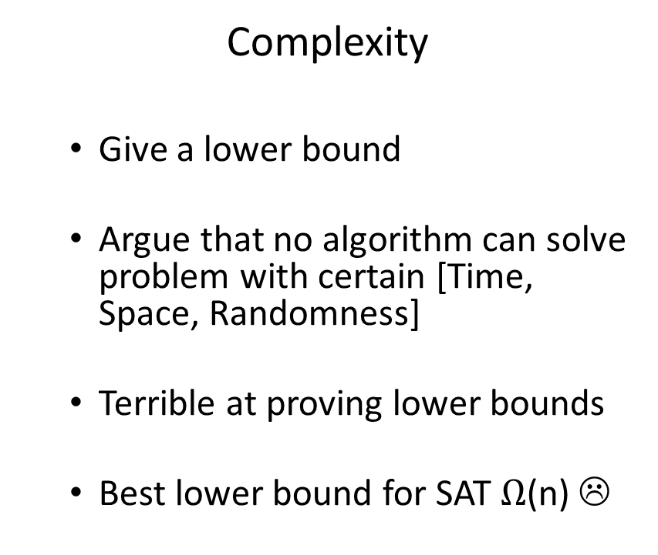
Algorithms vs Complexity
Algorithms
  Come up with a strategy for a problem
  Argue that the strategy works and runs in certain [Time, Space, Randomness]
  Awesome at coming up with algorithms
Complexity
  Give a lower bound
  Argue that no algorithm can solve problem with certain [Time, Space, Randomness]
  Terrible at proving lower bounds
  Best lower bound for SAT $Ω$(n) ☹

Slide 4
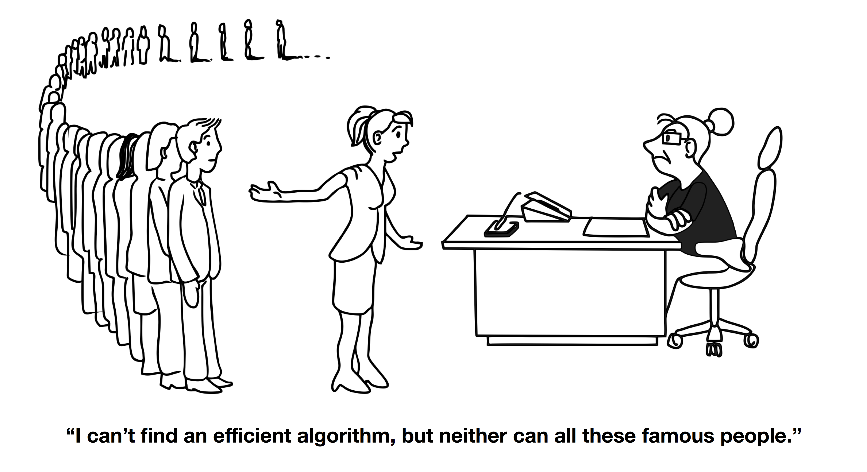
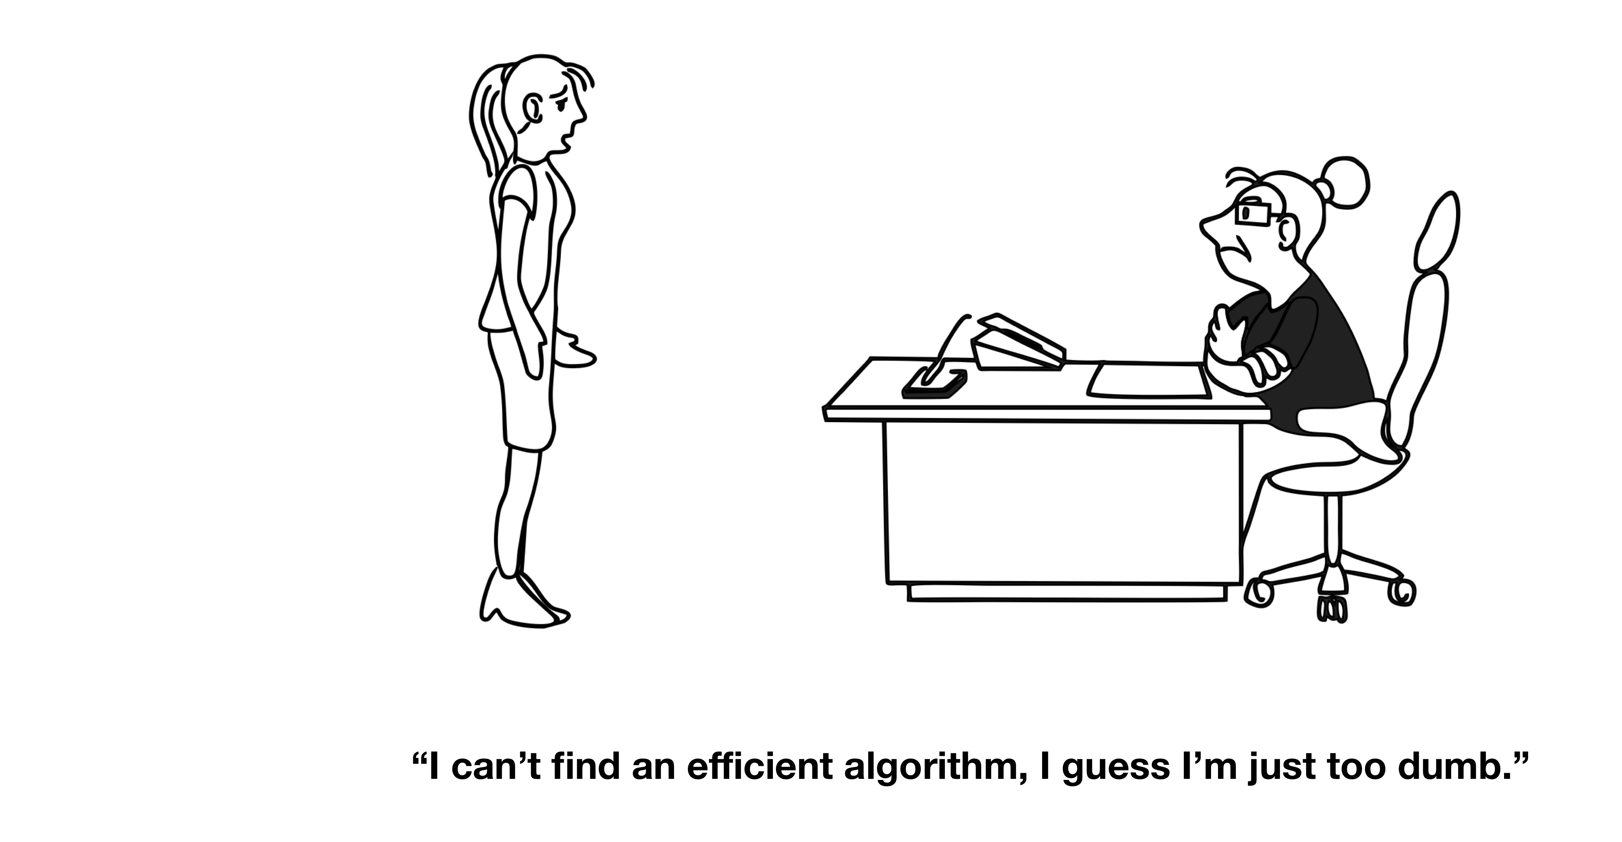
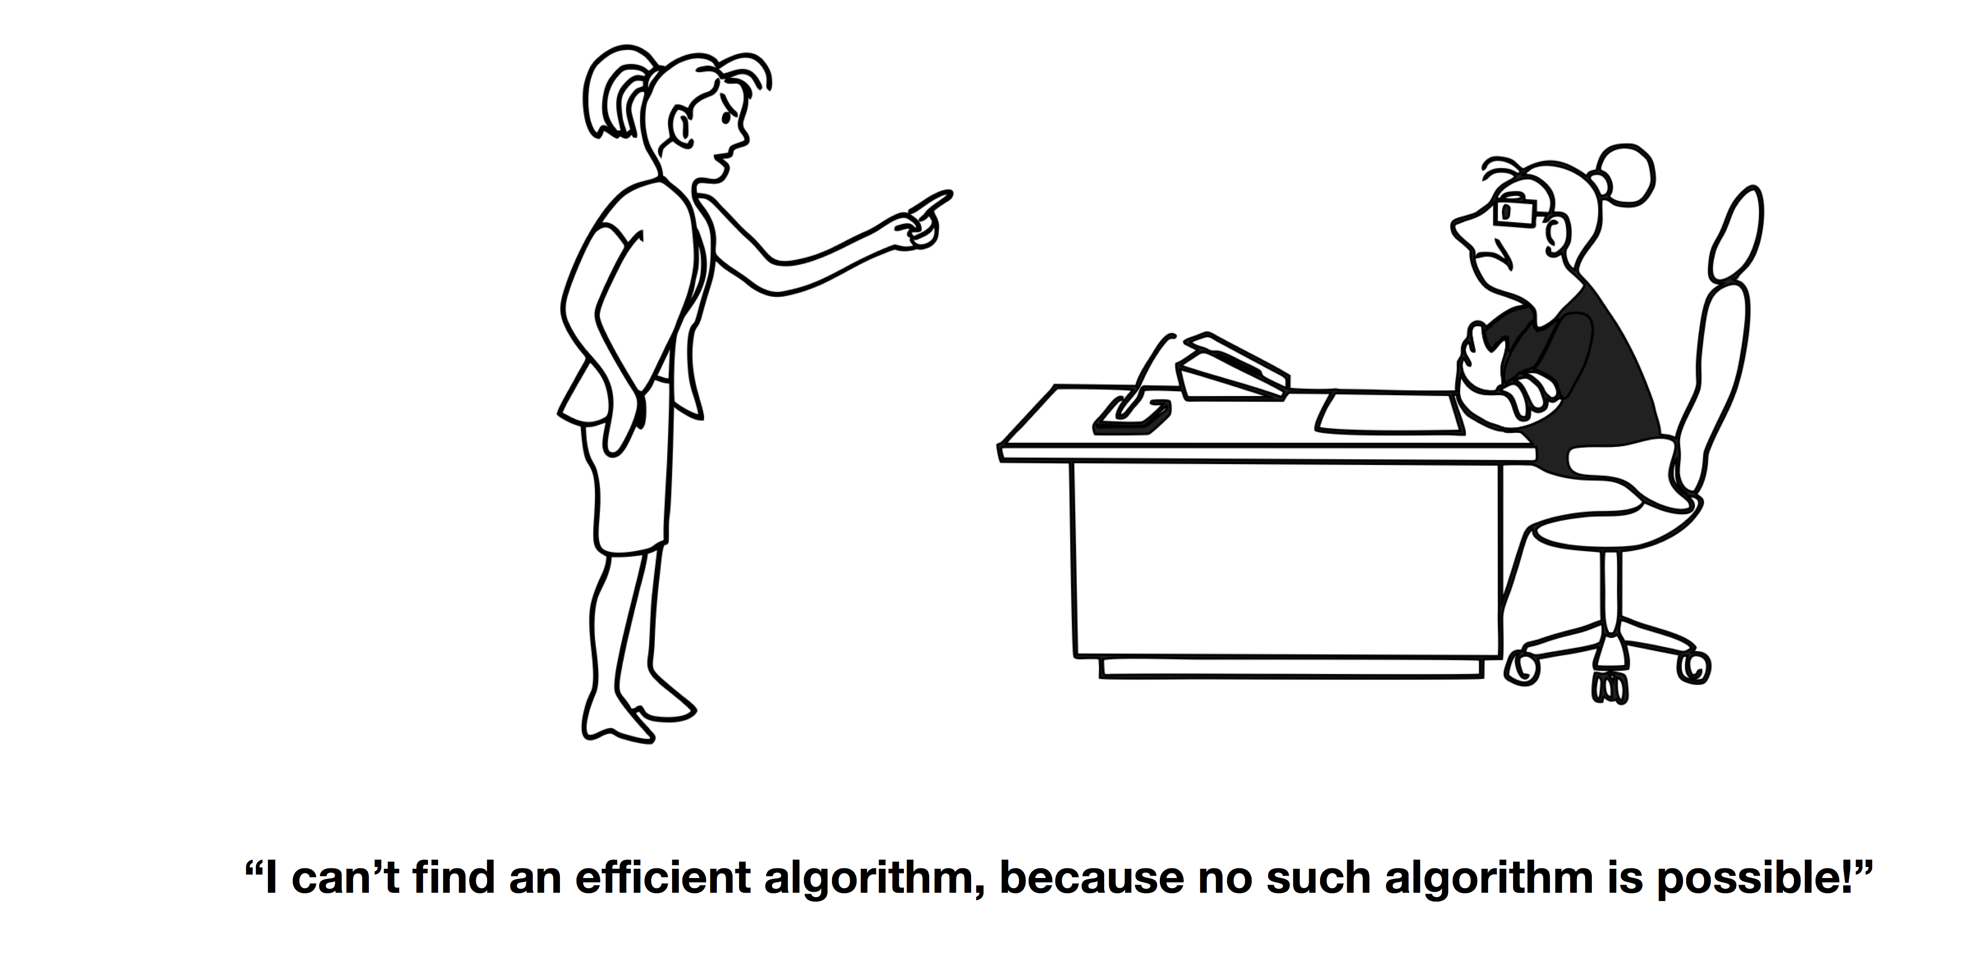

Slide 5
Cryptography vs Complexity
Complexity
  Prove that a problem is hard
  Show that no algorithm running in [Time, Space, Randomness] can solve such problem
  Show equivalence between hardness of problems
Cryptography
  Assume that a problem is hard
  Now construct primitives like Encryption, Secret Sharing, PRGs
  If there is an adversary that can break any of your primitives, then adversary can solve hard problem
  CONTRADICTION!!!

Slide 6
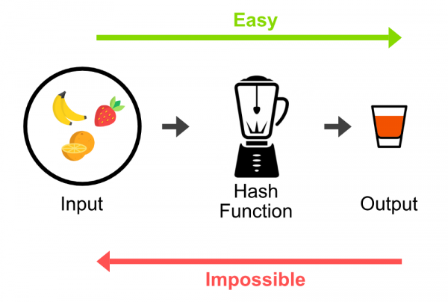
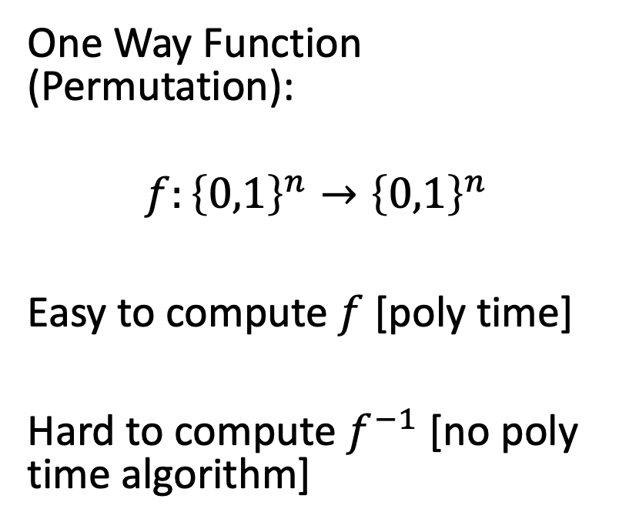
The Cryptographer Toolkit
One Way Function (Permutation):
$$f:{\left\{0,1\right\}}^{n}→{\left\{0,1\right\}}^{n}$$
Easy to compute $f$ [poly time]
Hard to compute $f^{−1}$ [no poly time algorithm]

Slide 7
The Cryptographer Toolkit
One Way Function (Permutation):
PRGs
Secret Key Encryption
Digital Signature Schemes
Secret Sharing Schemes
Commitment Schemes
Many many wonderful crypto objects

Slide 8



Tossing Coins over Telephone
Alice
Bob

Slide 9

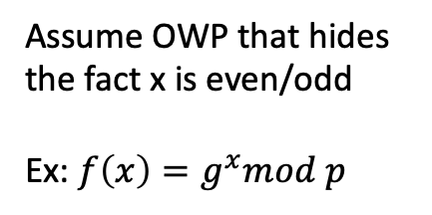
Tossing Coins over Telephone
Assume OWP that hides the fact x is even/odd
Ex: $f\left(x\right)=g^{x}mod p$
Alice pick random r, and sends$f(r)$
Bob sends guess if r is odd/even
Alice sends r
Alice
Bob

Slide 10
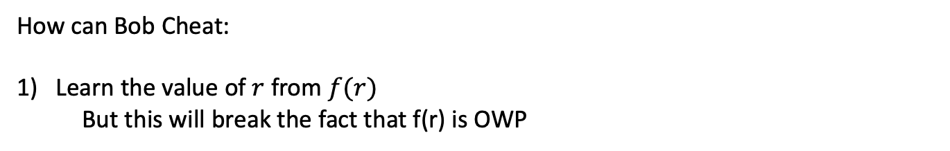
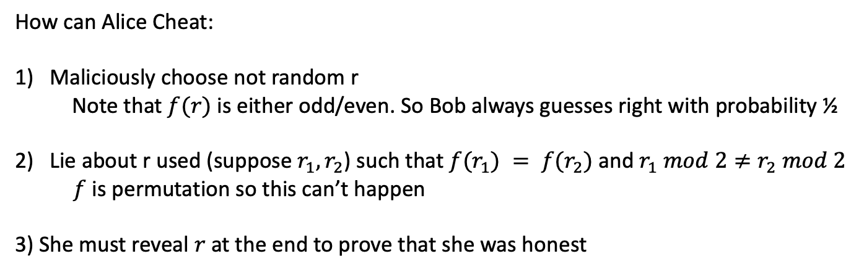
Tossing Coin over Telephone
How can Alice Cheat:
Maliciously choose not random r
  Note that $f(r)$ is either odd/even. So Bob always guesses right with probability ½
Lie about r used (suppose$r_{1}, r_{2}$) such that $f(r_{1}) = f(r_{2})$ and $r_{1} mod 2≠r_{2} mod 2$
$f$ is permutation so this can’t happen
3) She must reveal $r$ at the end to prove that she was honest
How can Bob Cheat:
Learn the value of $r$ from $f(r)$
But this will break the fact that f(r) is OWP

Slide 11
Cryptography in Class
Information theoretic:
  One-Time-Pad, Secret Sharing [only need randomness], no adversary running in infinite time can break such schemes
  (not the most practical)
Secret Key Encryption (SKE):
  Stream Ciphers, (AES Cipher)
  (practical but requires Alice and Bob to share key first)
Public Key Encryption (PKE):
  RSA , Discrete Log
  (practical and amazing, Alice and Bob never have to meet)

Slide 12
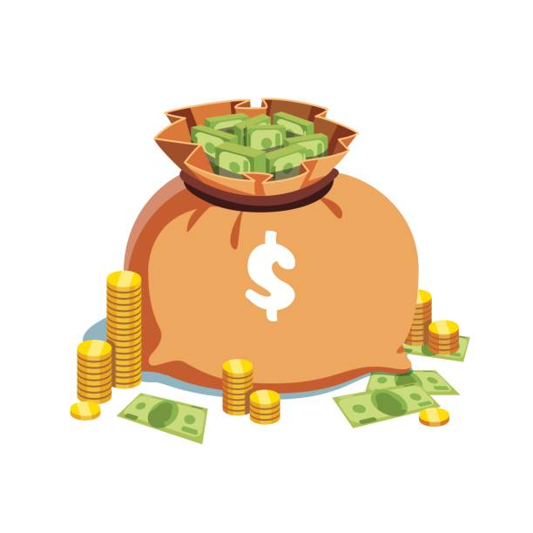
Quick Review of P vs NP
Collect Bounty
1,000,000 dollars
P: Problems that can be solved in polynomial time
Examples: Linear Programming, Sorting, Maximum Matching
All Public Key Crypto:
Factoring, Discrete Log are not believed to be NP-hard : (
NP: Problems whose solution can be verified in polynomial time
Examples: SAT, Graph-Coloring, Integer Programming
P vs NP: Is coming up with a solution as easy as verifying a solution?
Belief: P $≠$ NP, and NP-hard problems should not be solvable efficiently

Slide 13
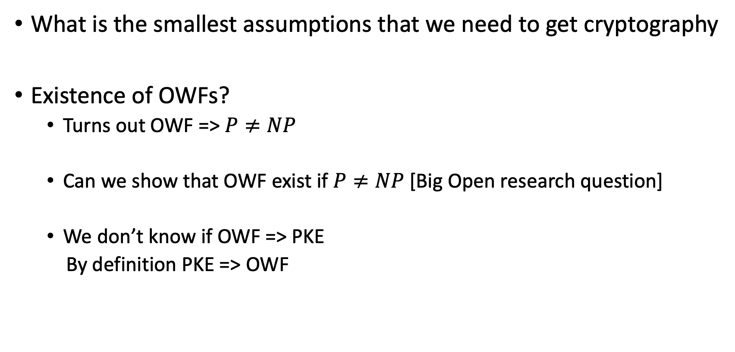
Minimal Assumptions of cryptography
What is the smallest assumptions that we need to get cryptography
Existence of OWFs?
  Turns out OWF => $P≠NP$
  Can we show that OWF exist if $P≠NP$ [Big Open research question]
  We don’t know if OWF => PKE
  By definition PKE => OWF

Slide 14
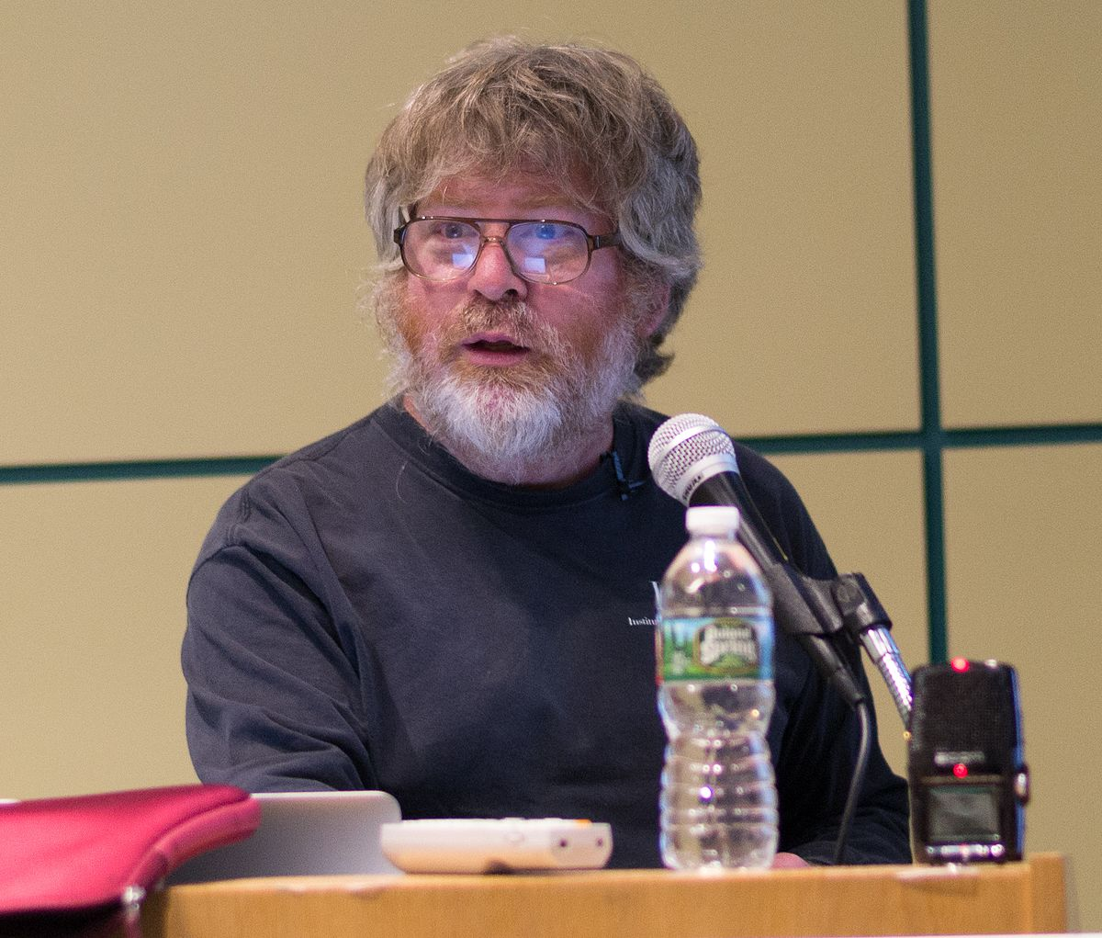
Impagliazzo’s Five Worlds
Algorithmica
Heuristica
Pessiland
Minicrypt
Cryptomania

Slide 15
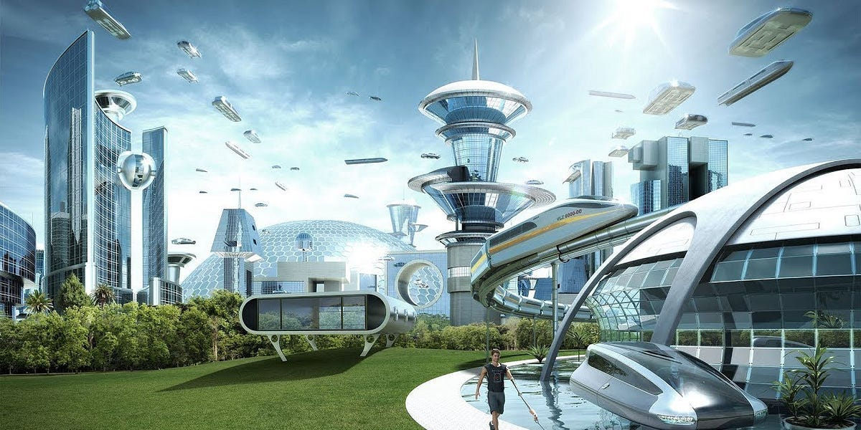
Algorithmica
P = NP
  Not only can I verify the solution, but I can also come up with it really fast
All hard problems we talked about have efficient algorithms:
Traveling Salesman, Factoring, Graph Coloring, SAT
Great for discoveries, fast algorithms means we can compute hard things
Awesome for Science, Optimization, Bioinformatics
Horrible for privacy/security [NO CRYPTOGRAPHY!!!!]

Slide 16
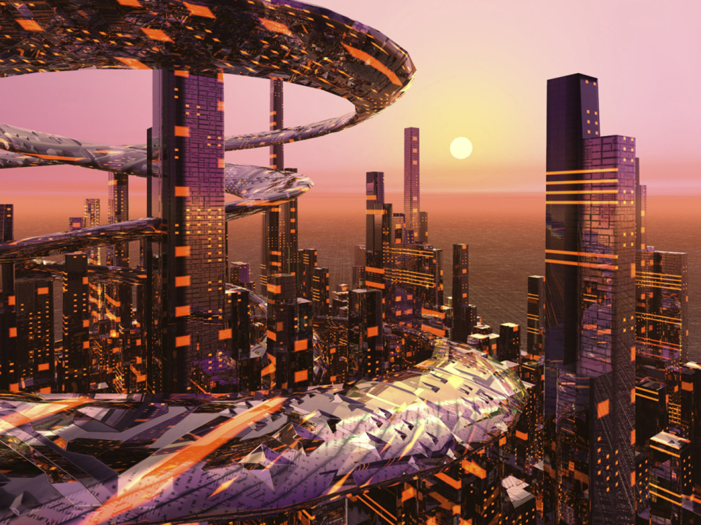
Heuristica
P != NP
But NP is easy on average
  Can solve most instances of a problem
  Can solve SAT on most formulas, 3-color most graphs, factor most numbers
For all practical purposes P = NP
  Almost Indistinguishable from Algorithmica
  Crypto Doesn’t exist: Finding hard instances of NP-hard problems is also hard

Slide 17
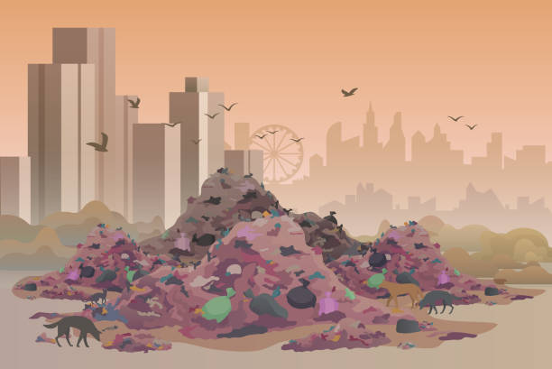
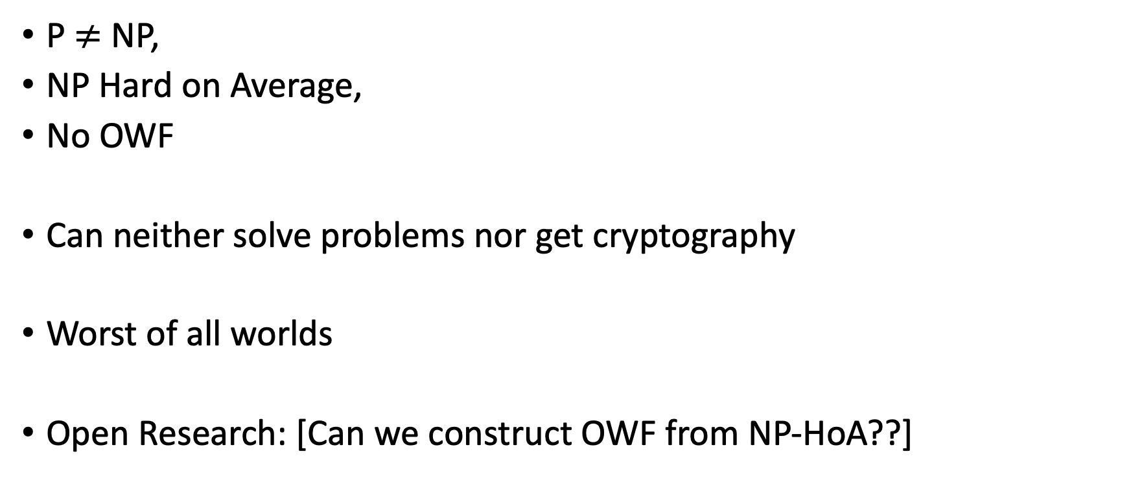
Pessiland
P $≠$ NP,
NP Hard on Average,
No OWF
Can neither solve problems nor get cryptography
Worst of all worlds
Open Research: [Can we construct OWF from NP-HoA??]

Slide 18
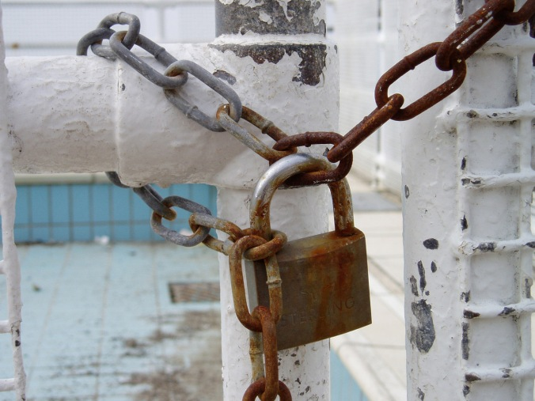
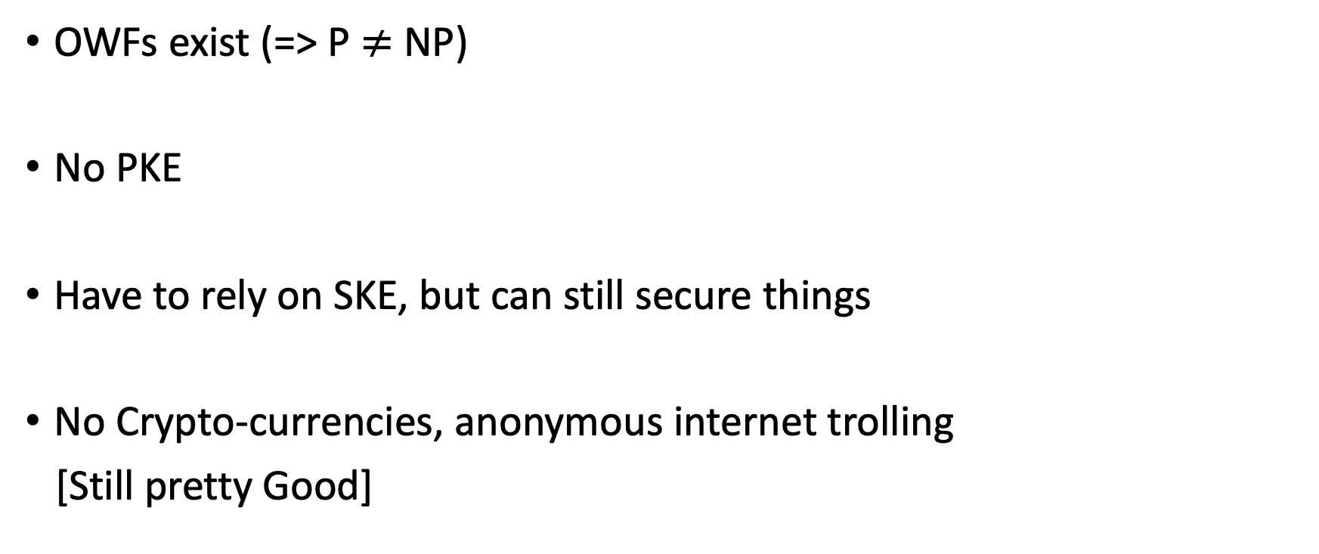
Minicrypt
OWFs exist (=> P $≠$ NP)
No PKE
Have to rely on SKE, but can still secure things
No Crypto-currencies, anonymous internet trolling
[Still pretty Good]

Slide 19
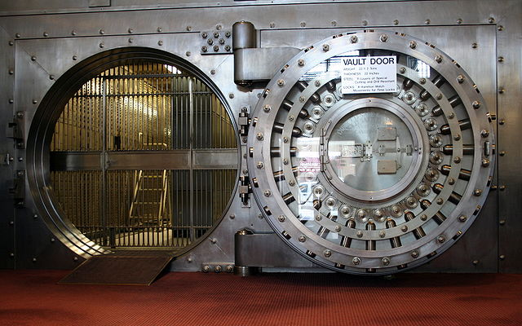
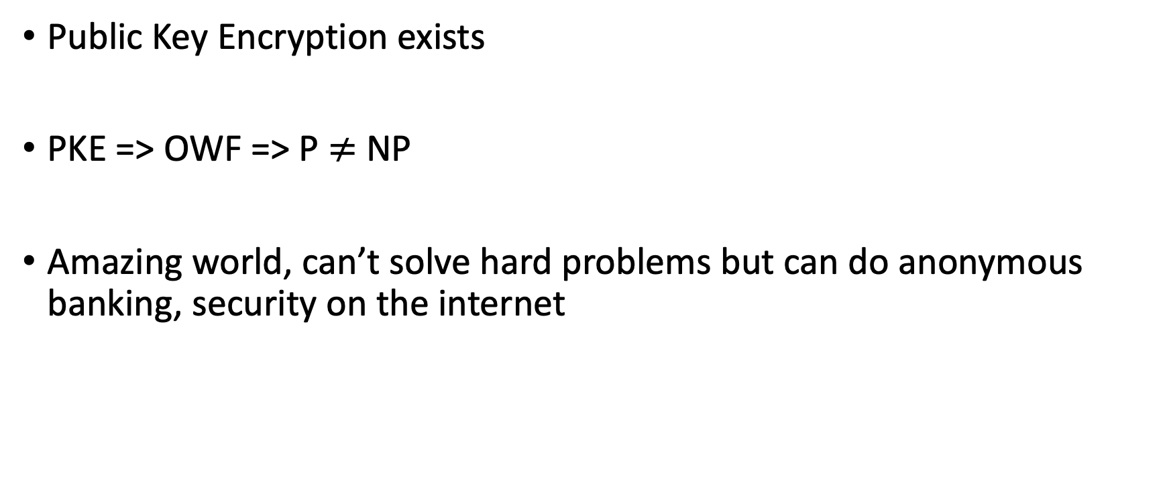
Cryptomania
Public Key Encryption exists
PKE => OWF => P $≠$ NP
Amazing world, can’t solve hard problems but can do anonymous banking, security on the internet

Slide 20
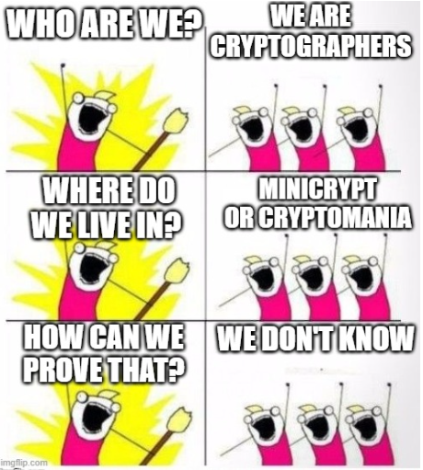
Which world do we live in
Very active line of research: Can we rule out certain worlds like Heuristica or Pessiland??
Lot of new progress in last few years, based on
Hardness of optimal compression algorithms

Slide 21
Interactive Proofs
What does it mean to prove something
Sequence of logical implications that convince you of a statement
In math proof is absolute, if it is correct, then any honest person can verify. No valid proof for false statements
What if we allow proofs where prover can cheat, but with very very small probability

Slide 22
Interactive Proofs
Alice is Colorblind
Bob wants to convince her that the balls are red and green?
What can we do?
Not clear that there is a way to convince Alice completely that the balls are different, she can never distinguish them herself?

Slide 23
Interactive Proofs
Alice takes the two balls
(Then behind her back she either swaps them or doesn’t)
She asks bob if she swapped them or not
Alice repeats this 10 times

Slide 24
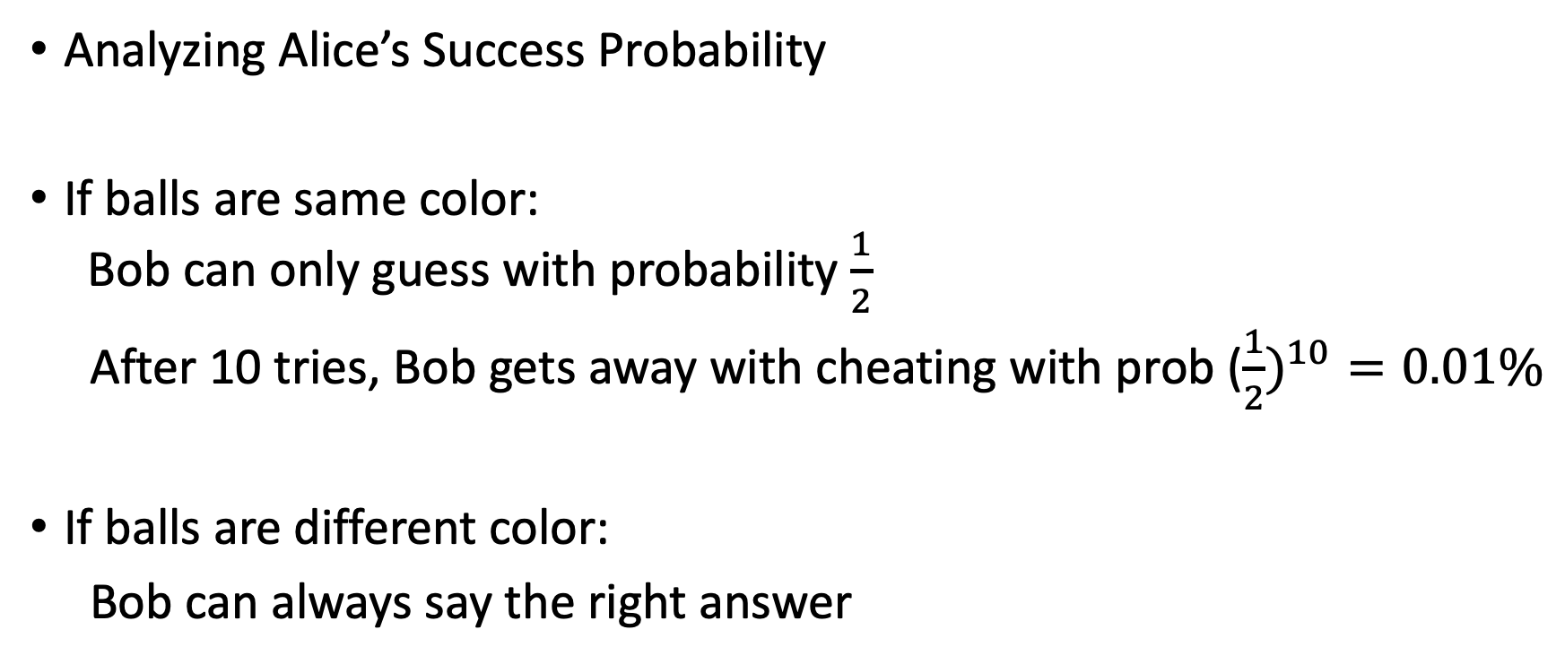
Interactive Proofs
Analyzing Alice’s Success Probability
If balls are same color:
Bob can only guess with probability $\frac{1}{2}$
After 10 tries, Bob gets away with cheating with prob (${\frac{1}{2})}^{10}=0.01\%$
If balls are different color:
Bob can always say the right answer

Slide 25
Zero Knowledge
Alice: Prove some statement
Bob: Verify Statement
Zero Knowledge: Bob only knows validity (either true or false)
Example: Prove to bob I have enough money to pay him, without showing him my bank balance

Slide 26
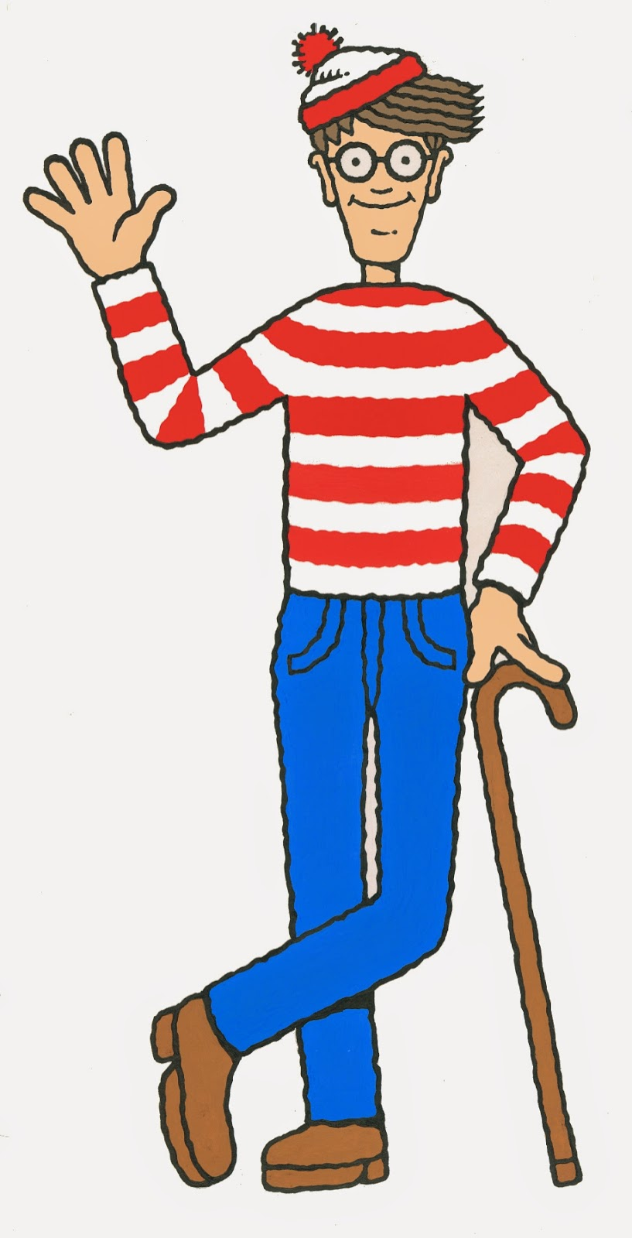
Where’s Wally?

Slide 27
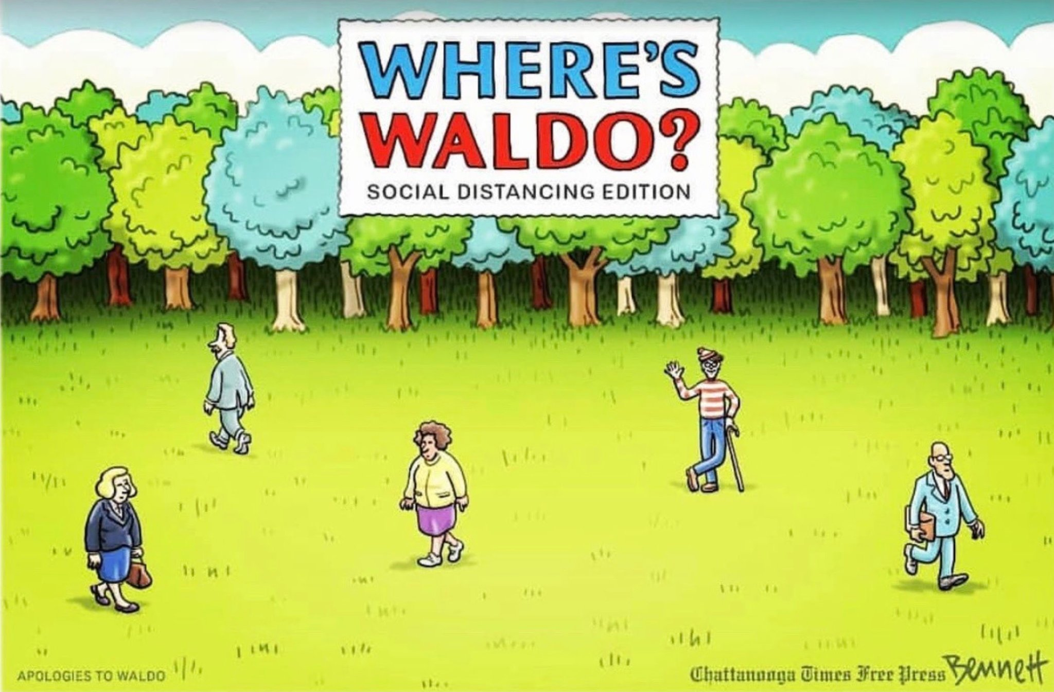
Where’s Wally?

Slide 28
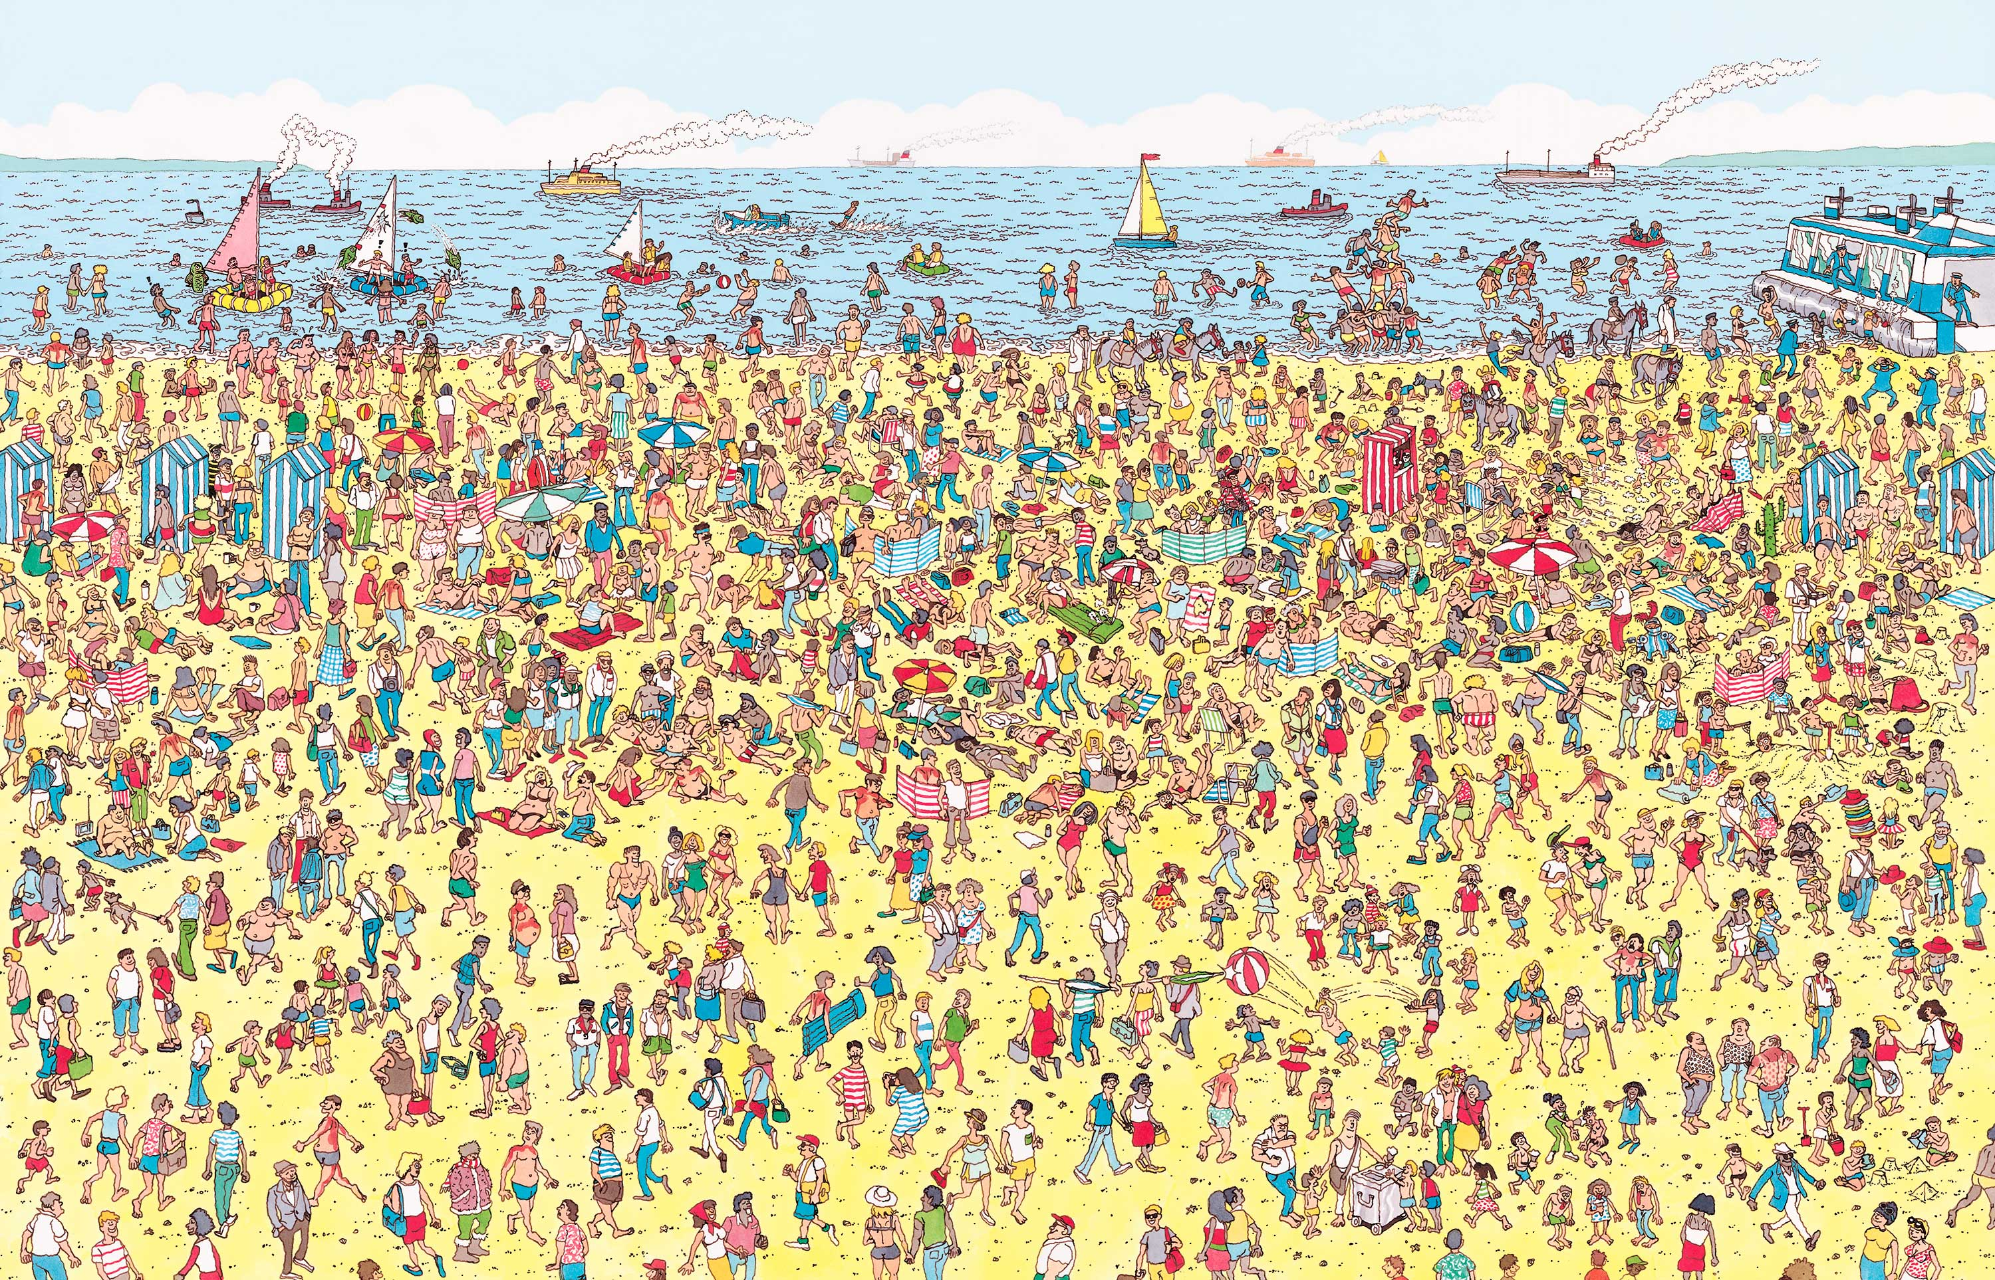

Slide 29


Slide 30
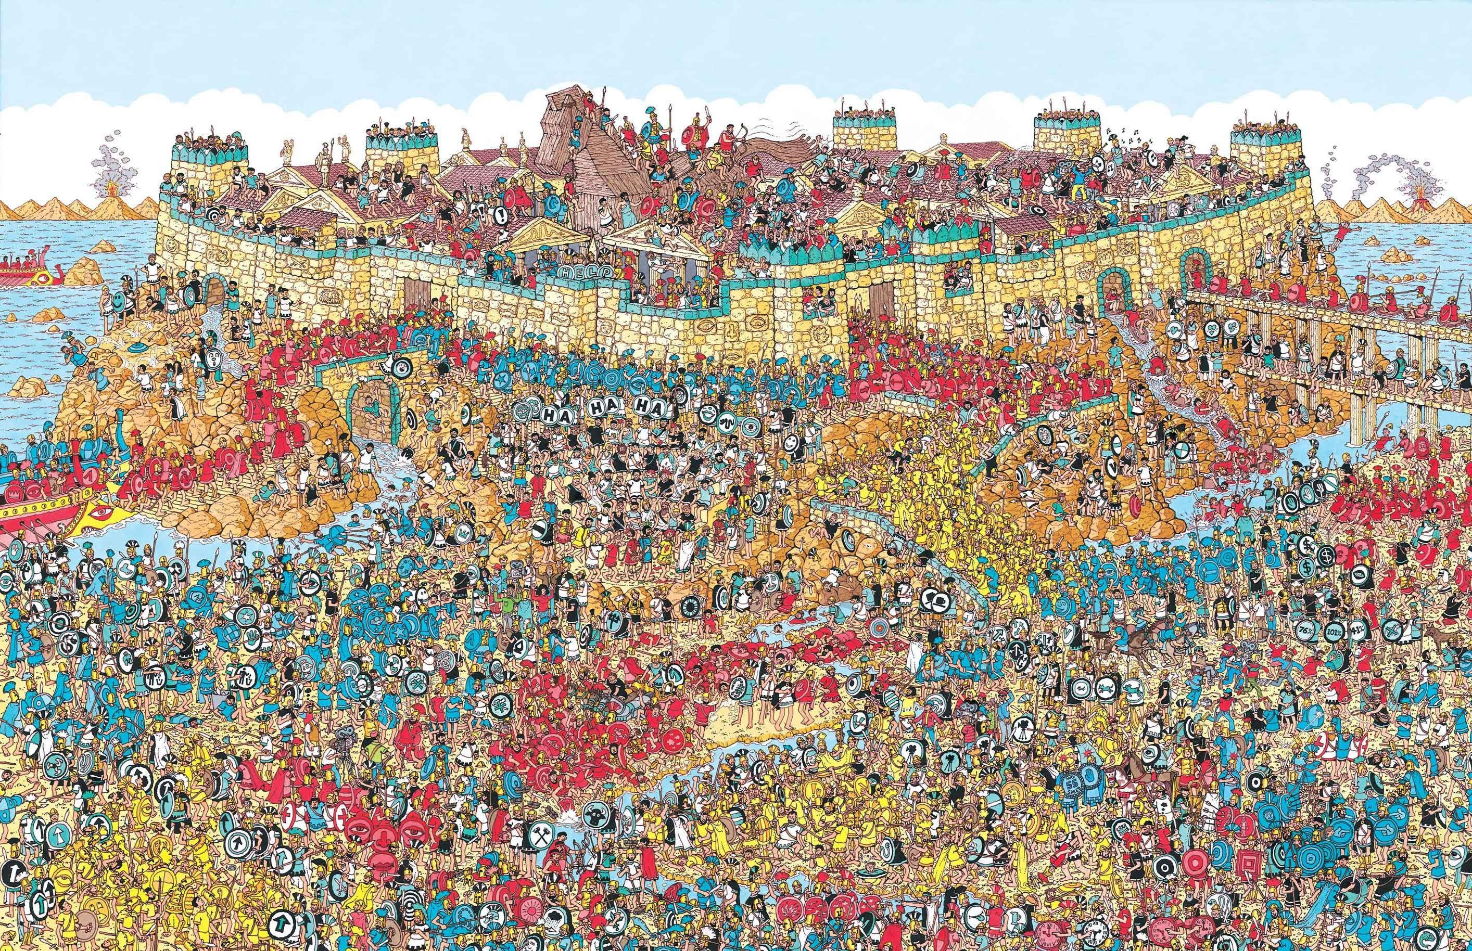

Slide 31
ZK Proof
Alice Cuts a cardboard twice as big as the image with a center cutout of wally
Now she rotates the image behind the cardboard till wally is placed through the cutout
Bob clearly sees Wally but doesn’t know where wally is

Slide 32


